Slide 1

TAG 12/09/2020
Garage Car Parking Aid

Slide 2
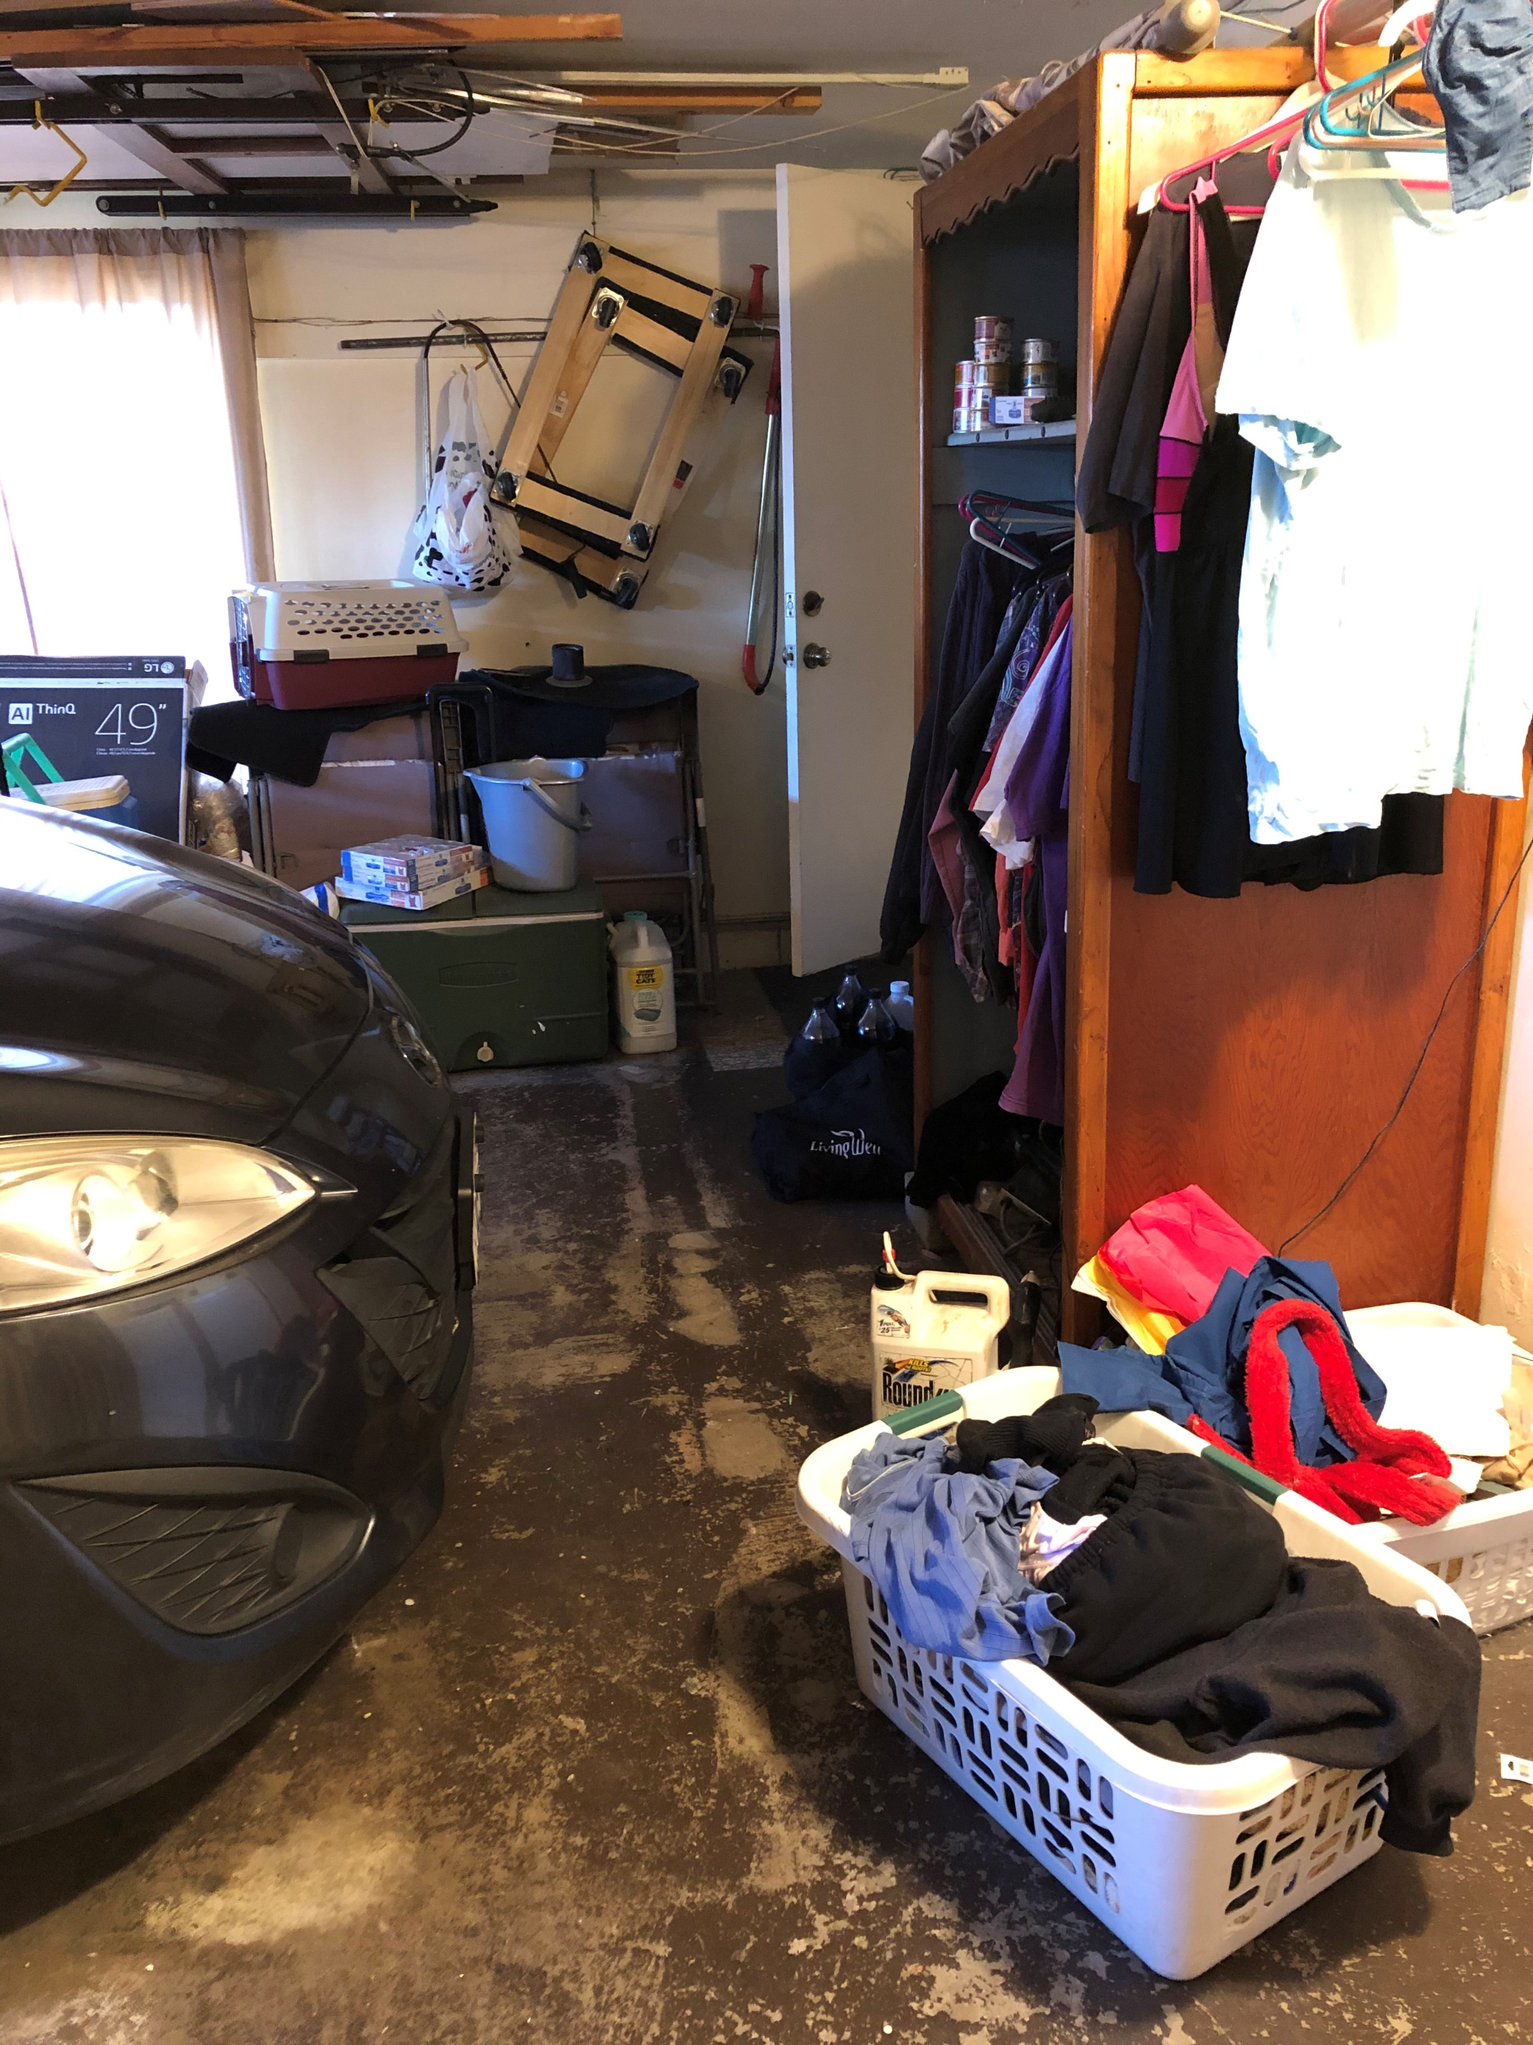
Pulling the Car in the Garage Just the Right Distance, Mankind's greatest challenge.
Since the end of the hood on my Mazda5 can not be seen by the driver, pulling the car in enough to clear the garage door but still provide a wide passage to the laundry area can be difficult.
A generation ago, people hung a tennis ball from the roof of the garage to solve this problem.
This minor problem offers a chance to play with an inexpensive rangefinder sensor and 3D print some cases and component mounts.

Slide 3
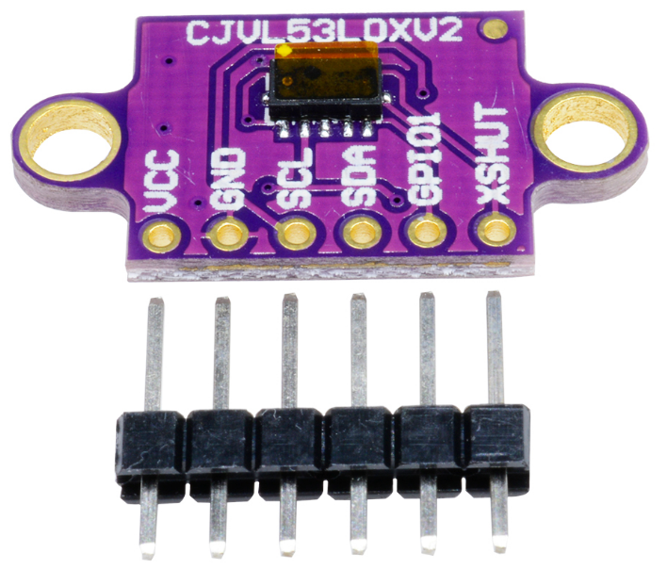
The sensor I used to detect the location of the car was the VL53LOXV2 Infrared Time-of-Flight Sensor
Range 2m with ±10% worst case accuracy
Arduino compatible I²C Interface
Mature Arduino libraries are available.
Cost $4.00

Slide 4
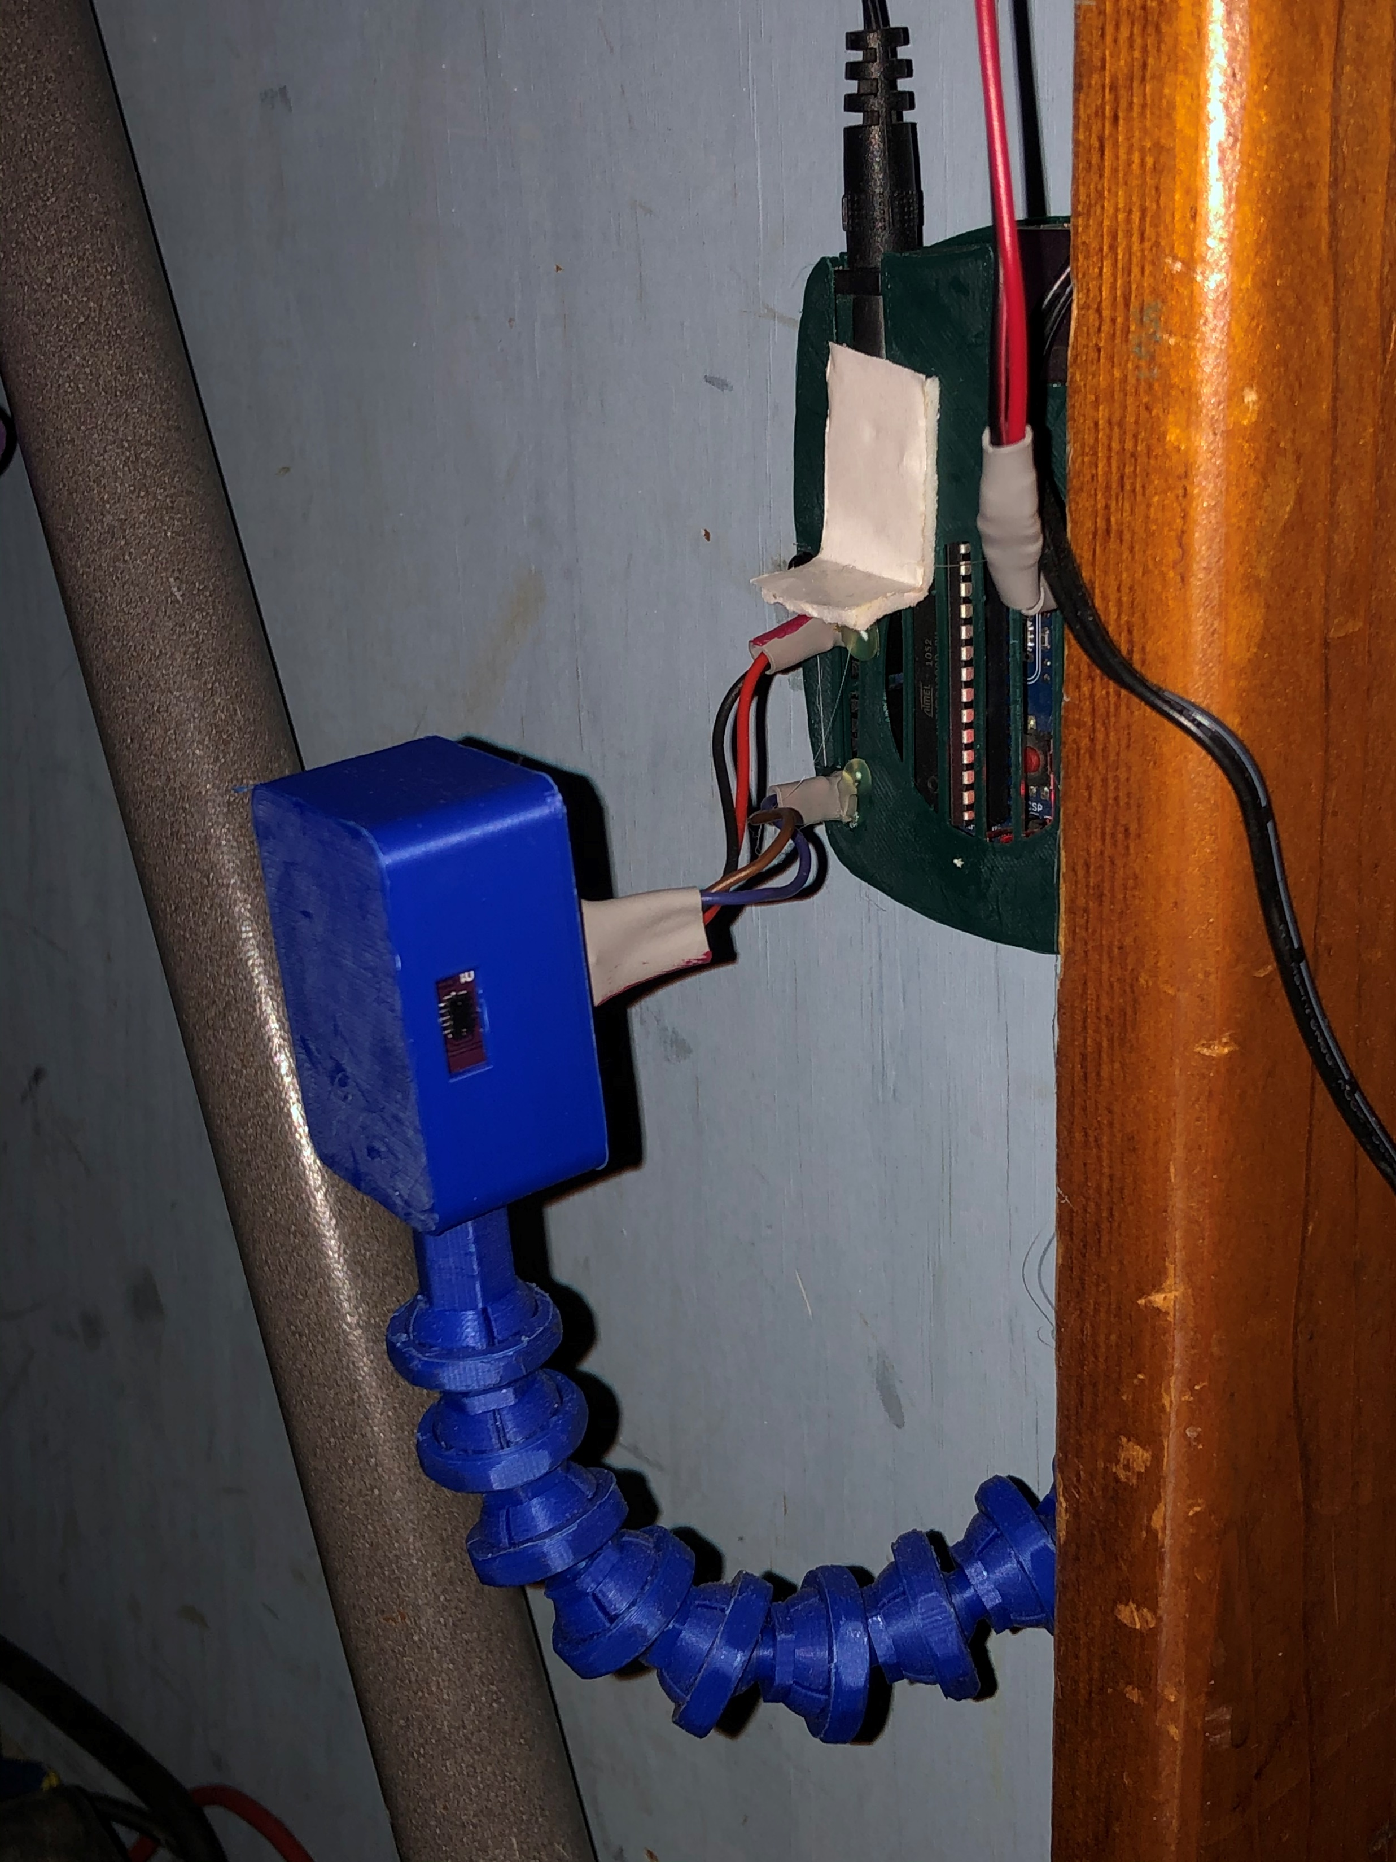
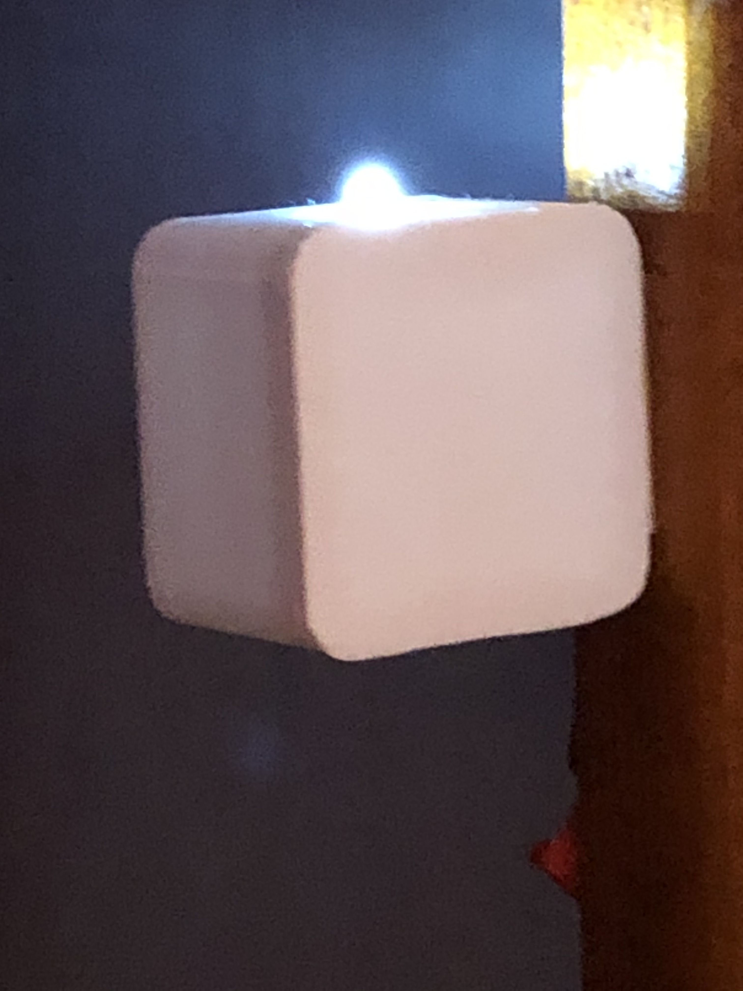
How Does It Work?
When nothing is near the sensor an LED is off.
When the distance from the front of the car to the sensor is just right, the LED turns on
If the car is too close, the LED blinks,
After 12 seconds in any state the LED turns off. If the sate changes it comes back on again.

Slide 5
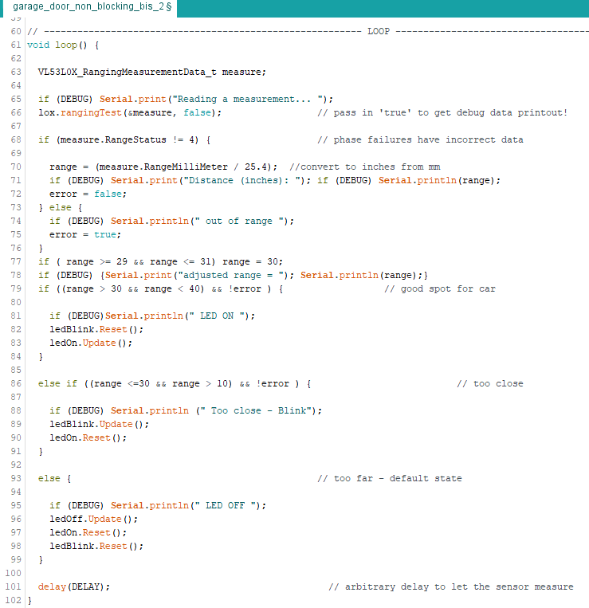
Software More Difficult than is Sounds
The only real challenge in this project was the issue of timing the 12 second shutoff, while timing the blinking of the LED, all while range finding. Using a simple delay() loop to blink the LED blocks the other functions. The solution to this problem is to use interrupts to drive each function. There already exist Arduino libraries for interrupt drive timing.

Slide 6
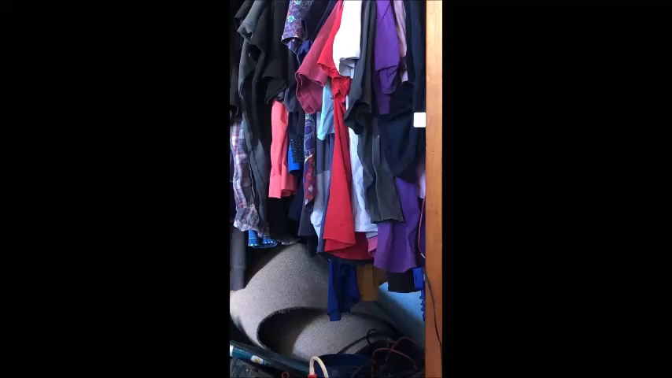
Does It Work?
Yes, it worked great!
Of course, if cloths on the cloths rack block the sensor then it can not see a thing.
Dust in the air or glare can cause it to flicker.

Slide 7

That’s it.
I hope you found this interesting. This is a simple Arduino project that could be used for lots of things.
Here is a link to the code.
Here is a link to the presentation.

