Slide 1

TAG 10/14/2020
Drying 3D Printing Filament

Slide 2
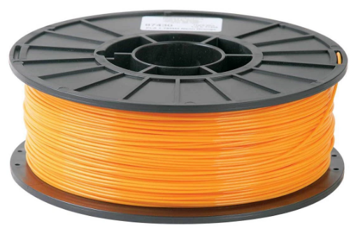
Does 3D Printing Filament Get Wet?
Yes. 3D printing filament is hydroscopic. Some filament types are more hydroscopic than others. PLA (Polylactic Acid), the most common filament, will absorb water out of the air rapidly.
Estimates of shelf life of the open product vary widely, from 2 to 6 weeks or longer.
It probably matters whether you live near Disneyland or Disneyworld.

Slide 3
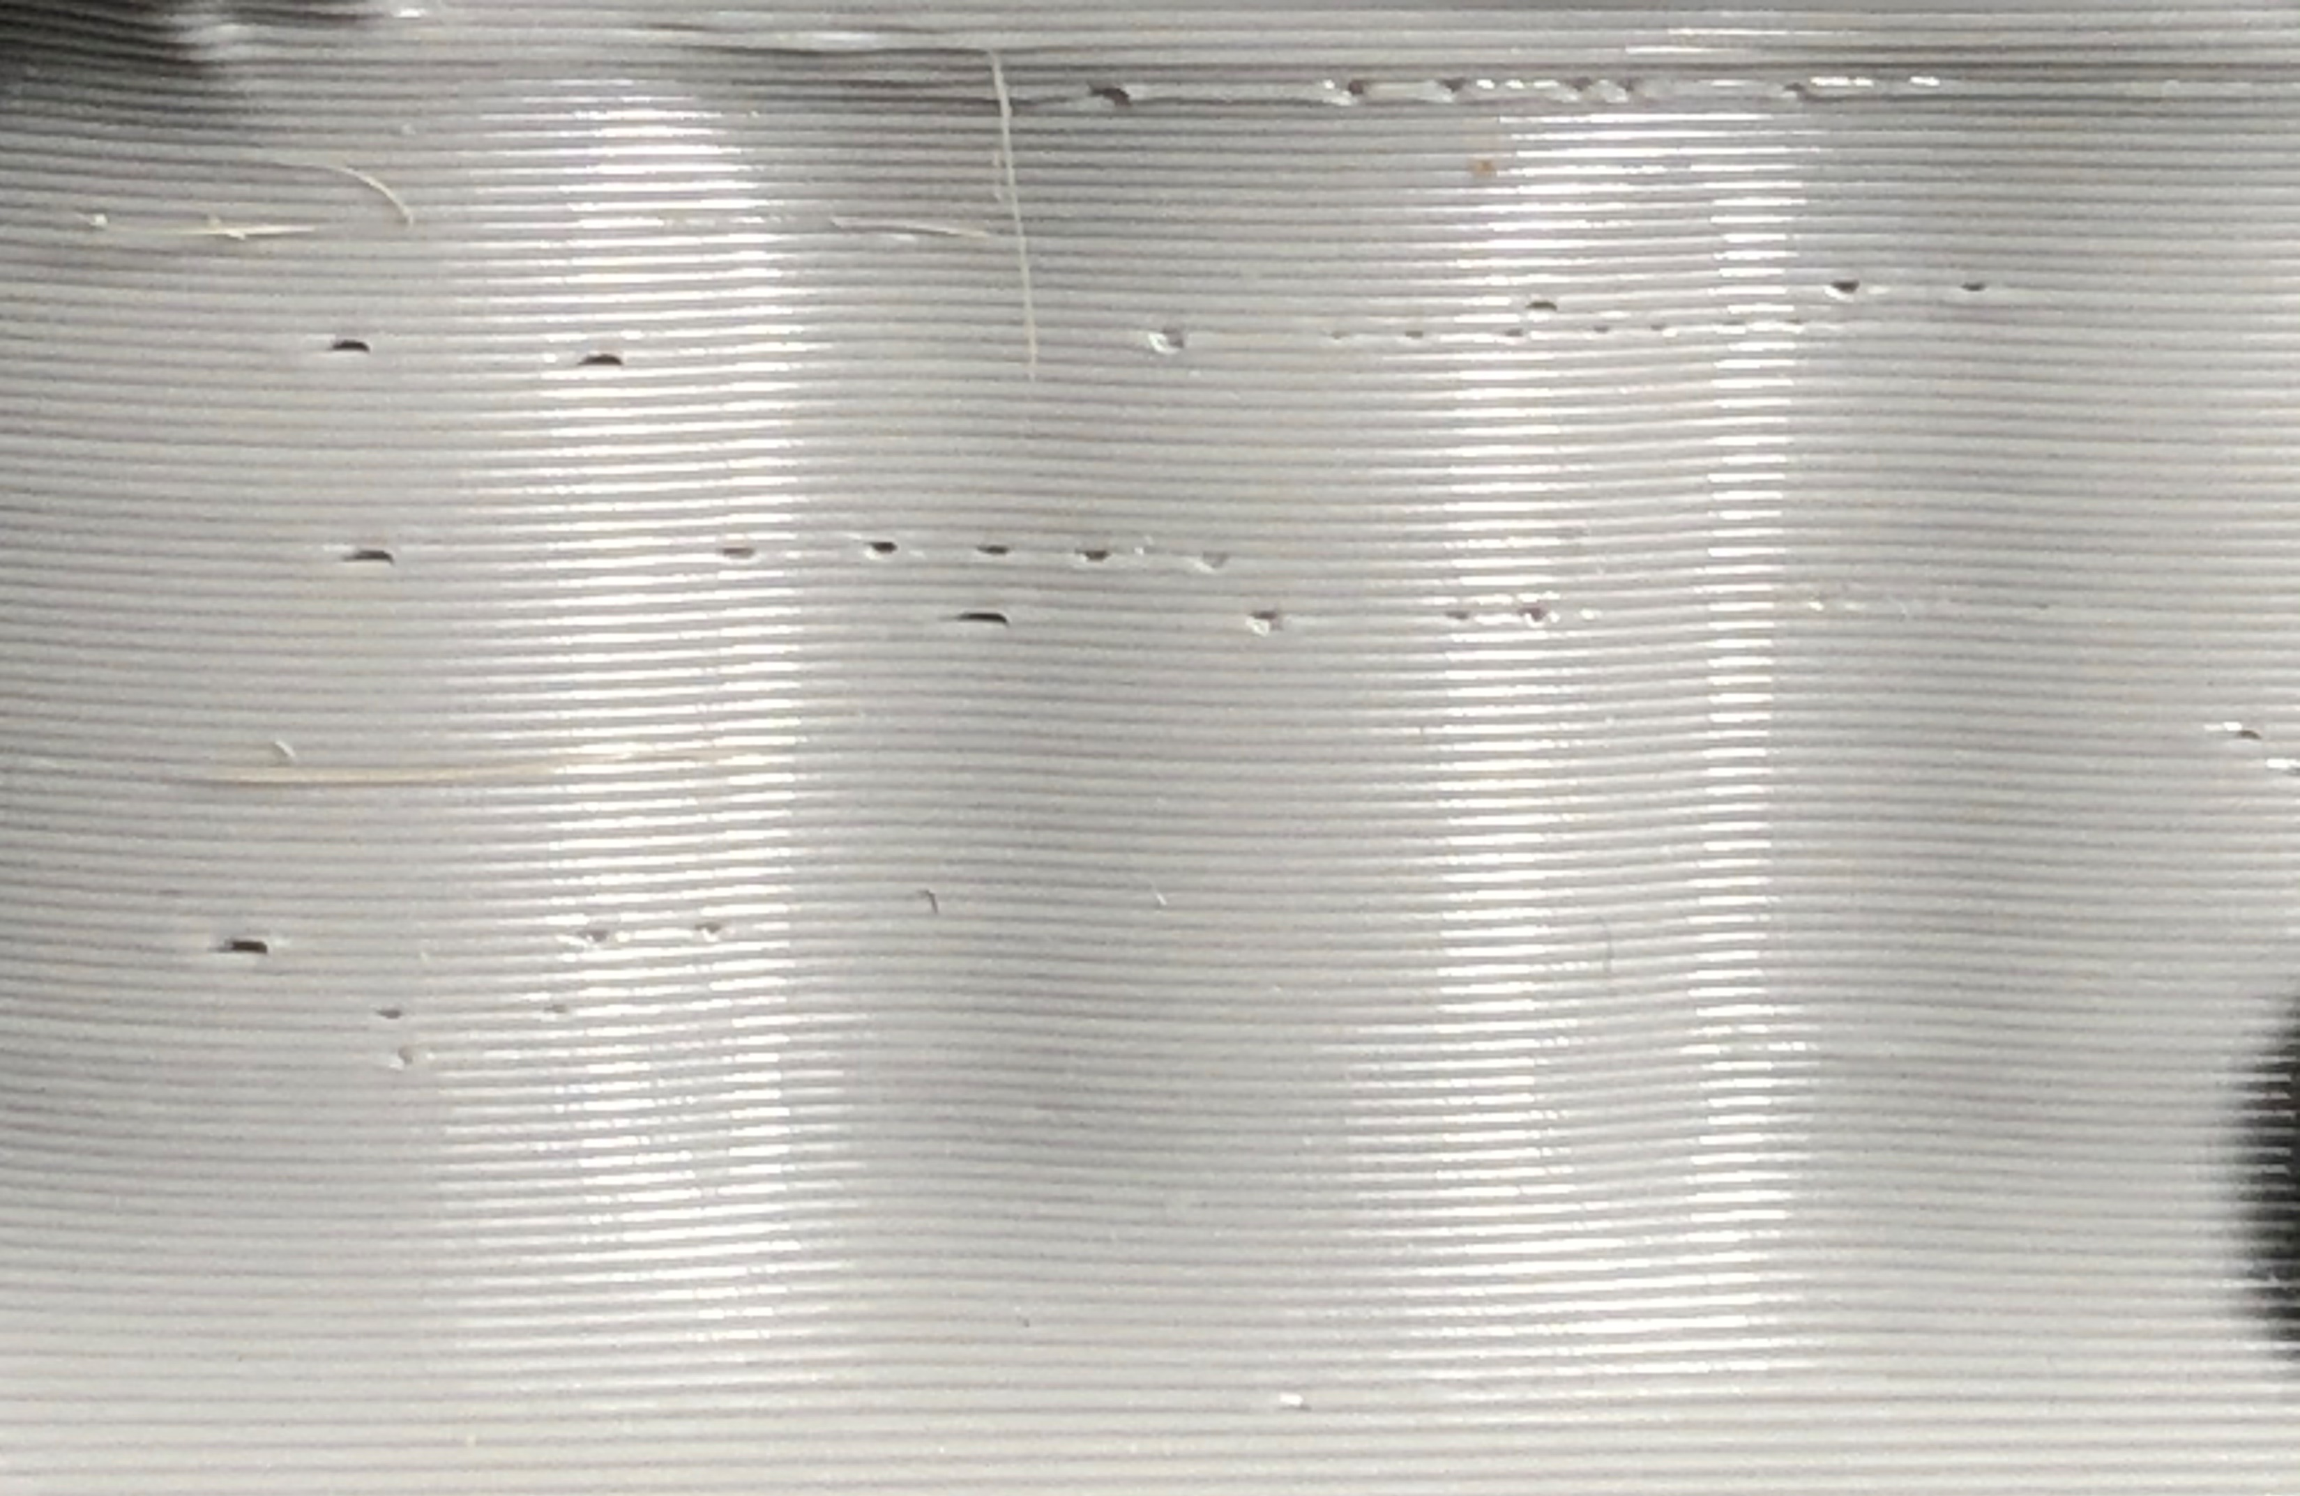
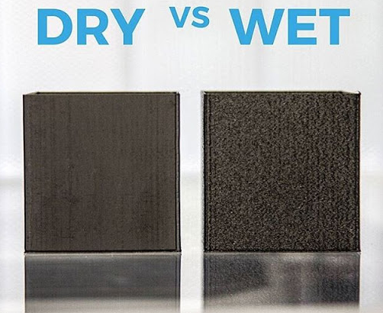
Problems with wet filaments
It can swell 40 micrometer (that’s a lot).
It can feed inconsistently, leaving voids.
It can get brittle and break.
Photo credit for Wet/Dry MadHatters

Slide 4
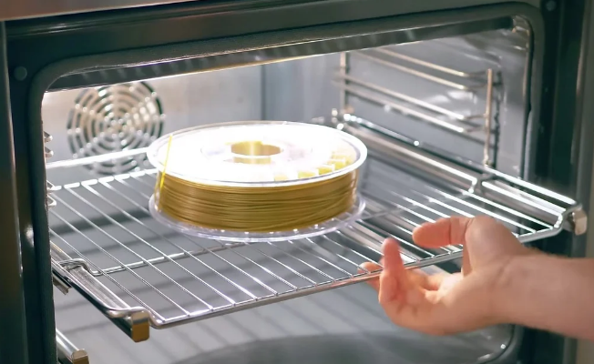
How to Dry Wet Filament
You can bake the water out. For PLA, 45˚C is recommended. Other filament types may need 80 ˚C.
Bake time is generally recommended to be 6+ hours.
Be careful not to overshoot or you can end up with a big lump of plastic.
You could use your oven but mine overshoots and will not go low enough.
Photo credit All3DP

Slide 5
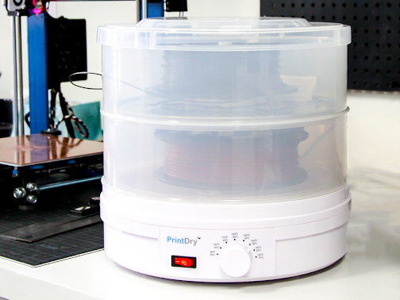
Other Drying Alternative
There are desiccators made for this purpose, but they are expensive.
Food dehydrators work too.
Considering that you are probably trying to salvage $5 worth of filament, spending $120 on a dryer does not seem reasonable.

Slide 6
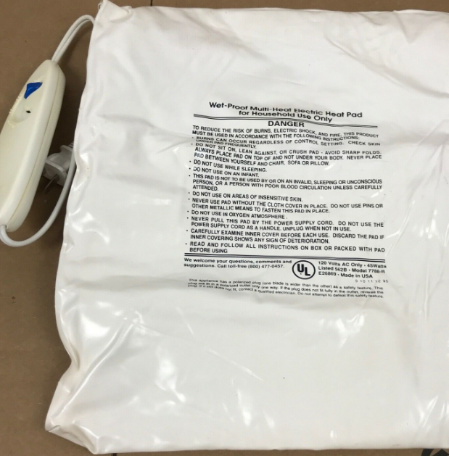
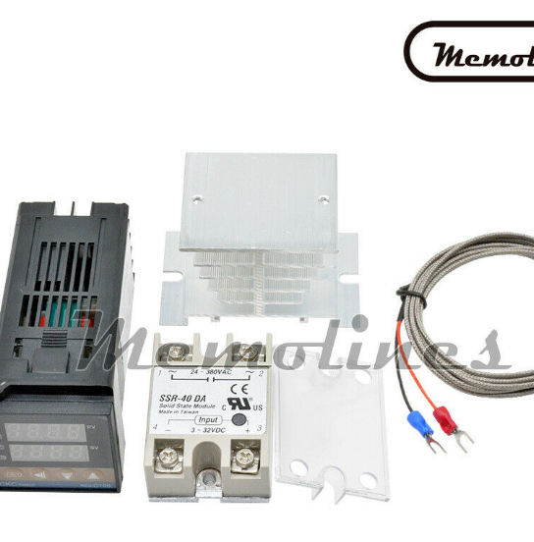
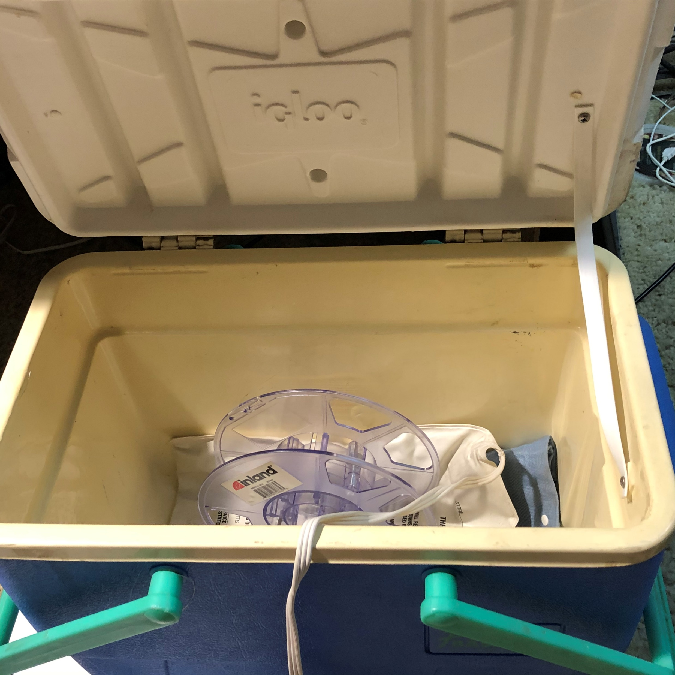
My Solution – Build your Own.
For a DIY solution, I used an ice chest, a 45w heating pad (the kind you would use for your back), and a cheap temperature controller purchased on eBay.
Use caution. None of this, except the heating pad, is anywhere near U.L. approved.

Slide 7
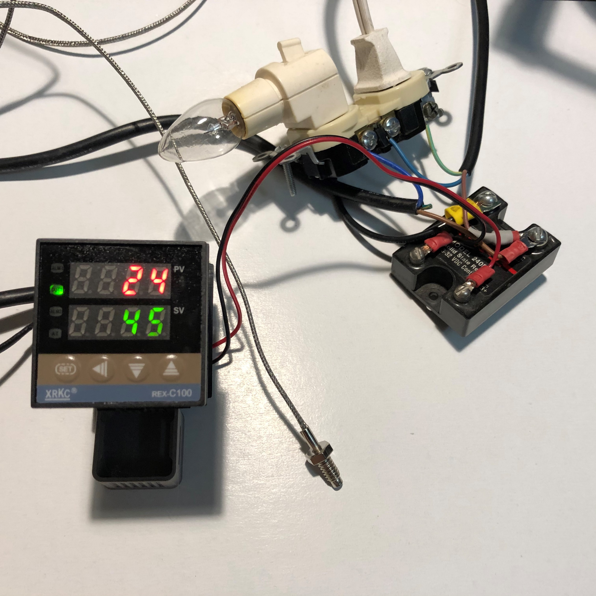
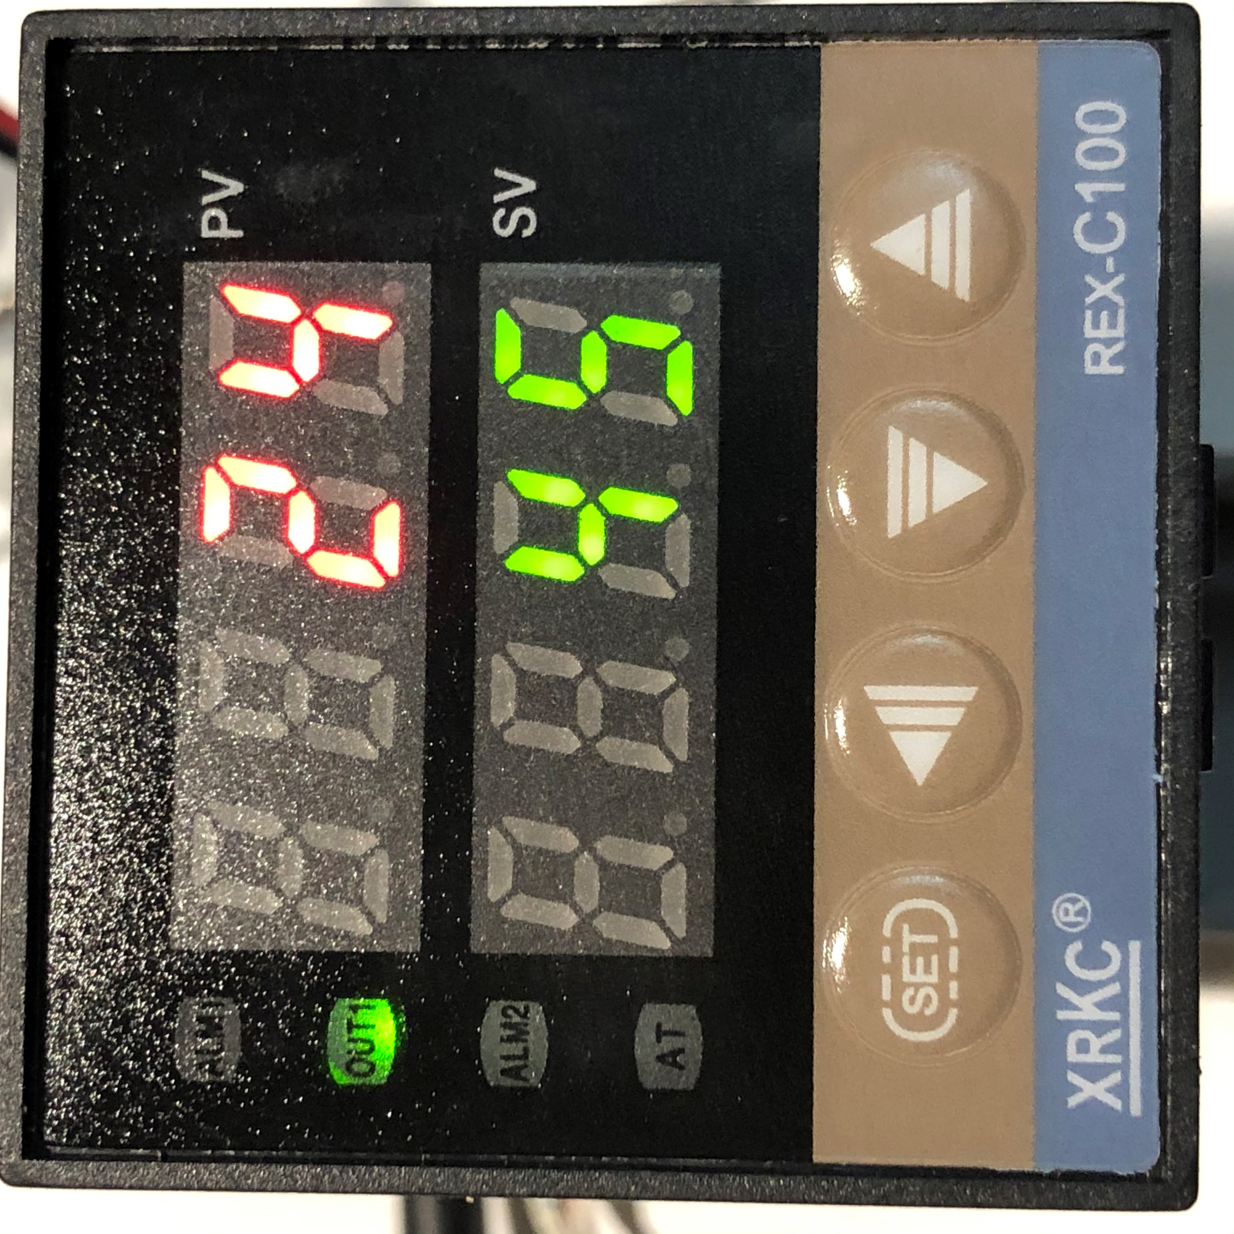
Does It Work?
Yes, it worked great! The performance of the cheap temperature controller is impressive. The PID control loop locked right to 45˚C without using AutoTune.
The little controller is designed to use an external solid-state relay. I have had one in my parts box that for the last 30 years.

Slide 8
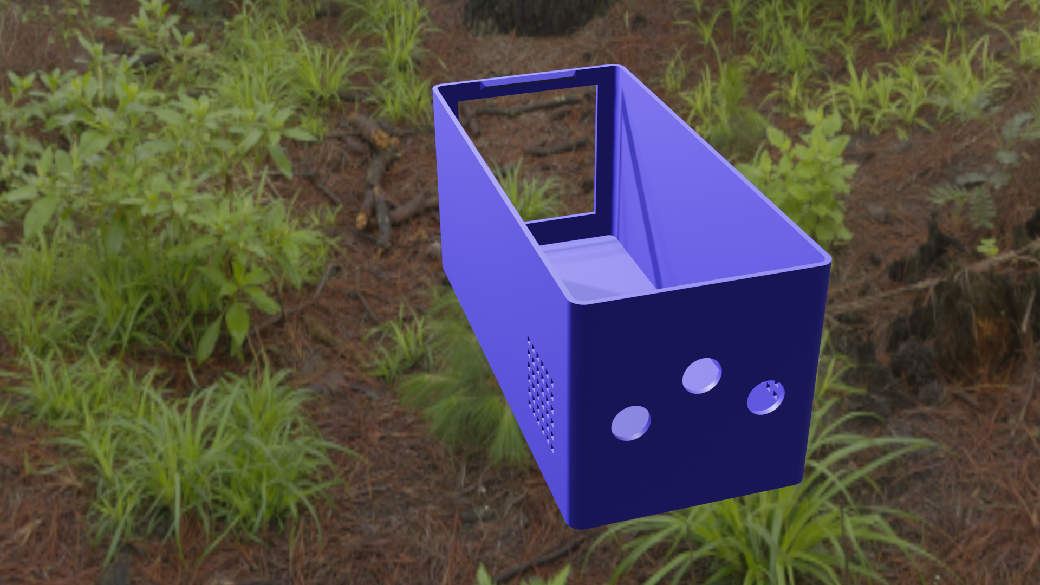
Of Course, I Printed a Case for It.

Slide 9
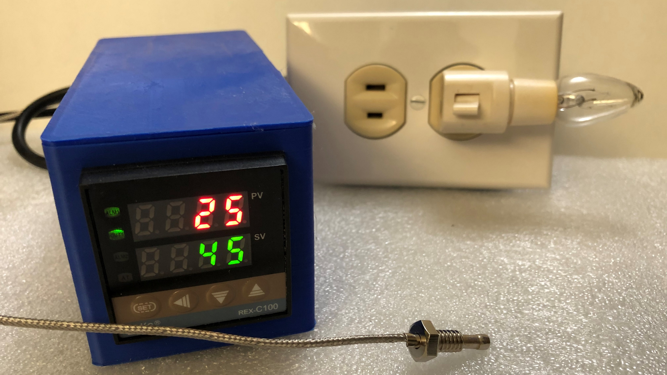
Controller in Enclosure

Slide 10
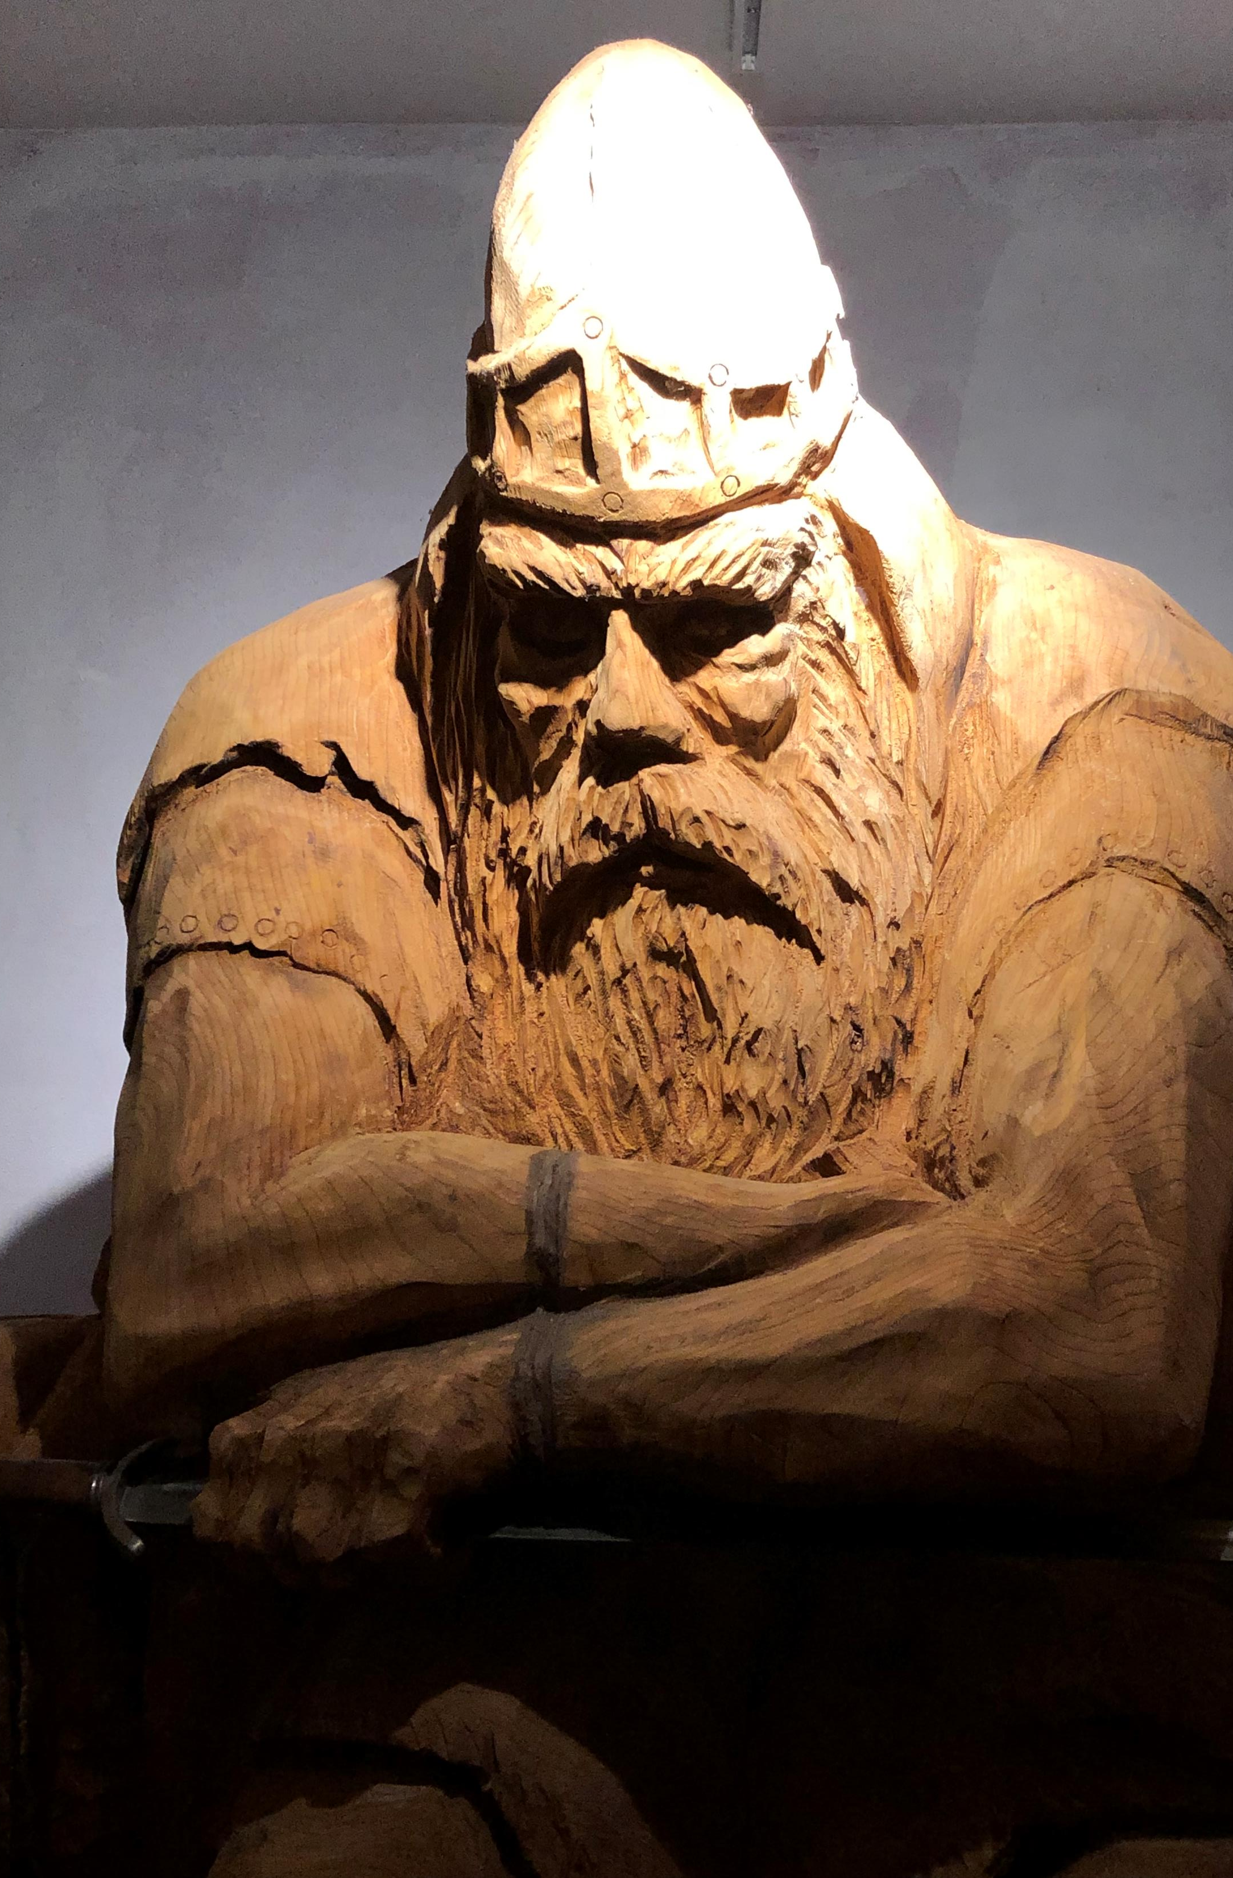
That’s it.
I hope you found this interesting. Even if you have no desire to do 3D printing or dry filament, I hope I gave you some ideas for low temperature baking.
Here’s the link for the temperature controller on eBay. Temperature Controller The complete controller set (inc. SSR) is only $16.00.

