Slide 1
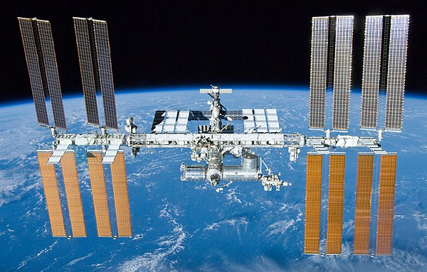

ARISS SSTV Event Scheduled from December 24 to 12/31
Starts 8 am PST 12/24/20 until noon PST 12/31/20

Slide 2
An ARISS Slow Scan TV (SSTV) event is scheduled from the International Space Station (ISS). This will be a special SSTV event to celebrate the 20th anniversary of ARISS on board the International Space Station. The event is scheduled to begin on December 24 at 16:40 UTC and continue through December 31 ending at 18:15 UTC. Dates are subject to change due to ISS operational adjustments.
Images will be downlinked at 145.8 MHz +/- 3 KHz for Doppler shift and the expected SSTV mode of operation is PD 120. Radio enthusiasts participating in the event can post images they receive at the ARISS SSTV Gallery at https://www.spaceflightsoftware.com/ARISS_SSTV/ .
After your image is posted at the gallery, you can acquire a special award by linking to https://ariss.pzk.org.pl/sstv/ and follow directions for submitting a digital copy of your received image.

Slide 3
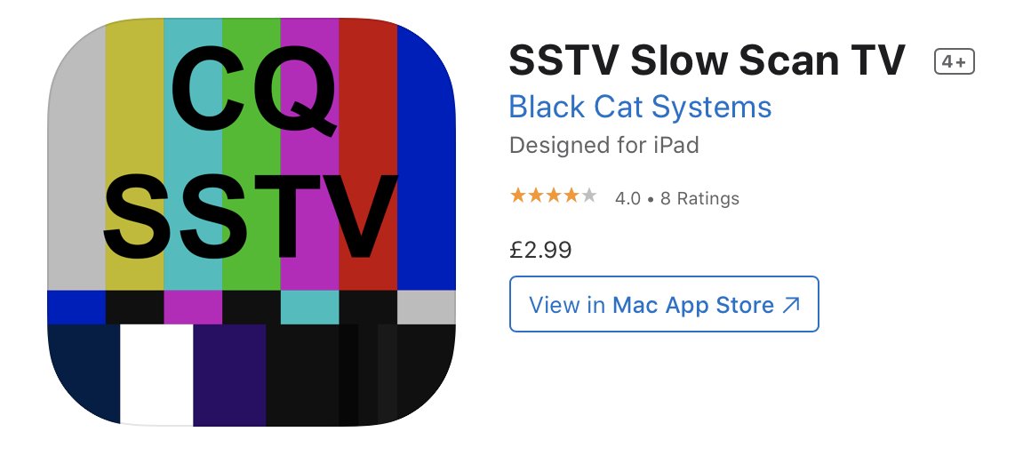
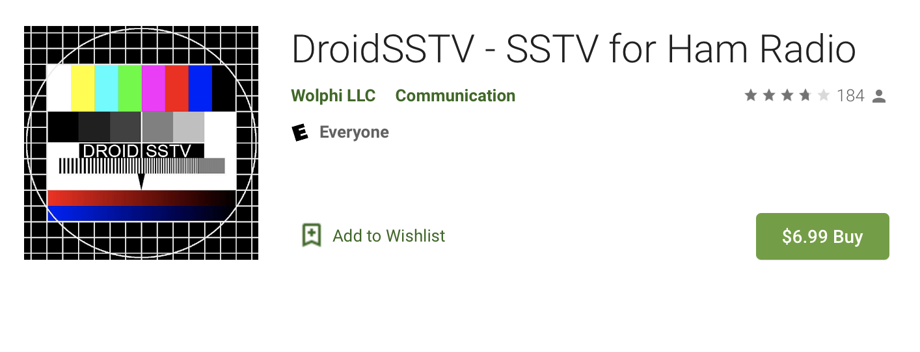
Apps
iOS (iPhone and iPad) - CQ SSTV by Black Cat Systems - $2.99 in the App Store
Android - DroidSSTV $6.99 in the Google Play store

Slide 4
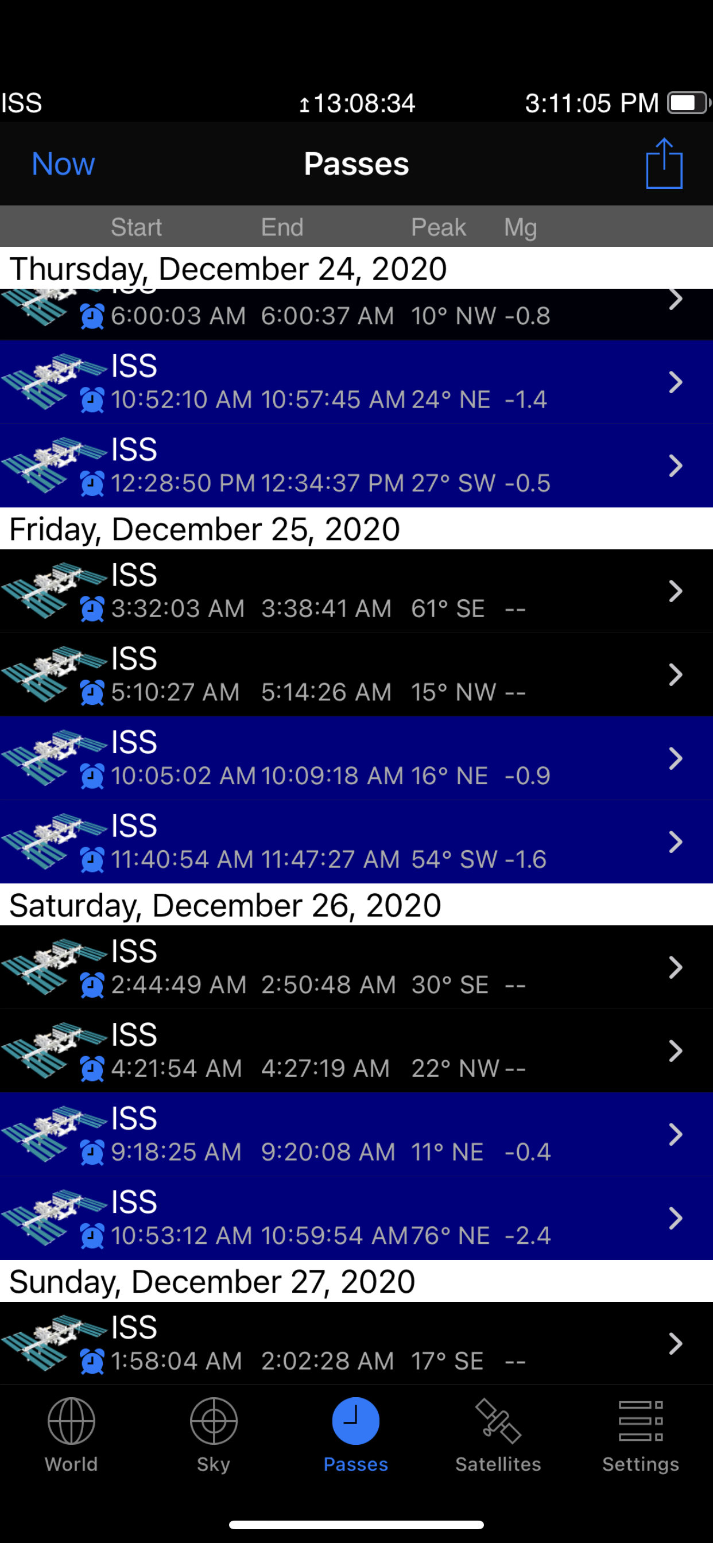
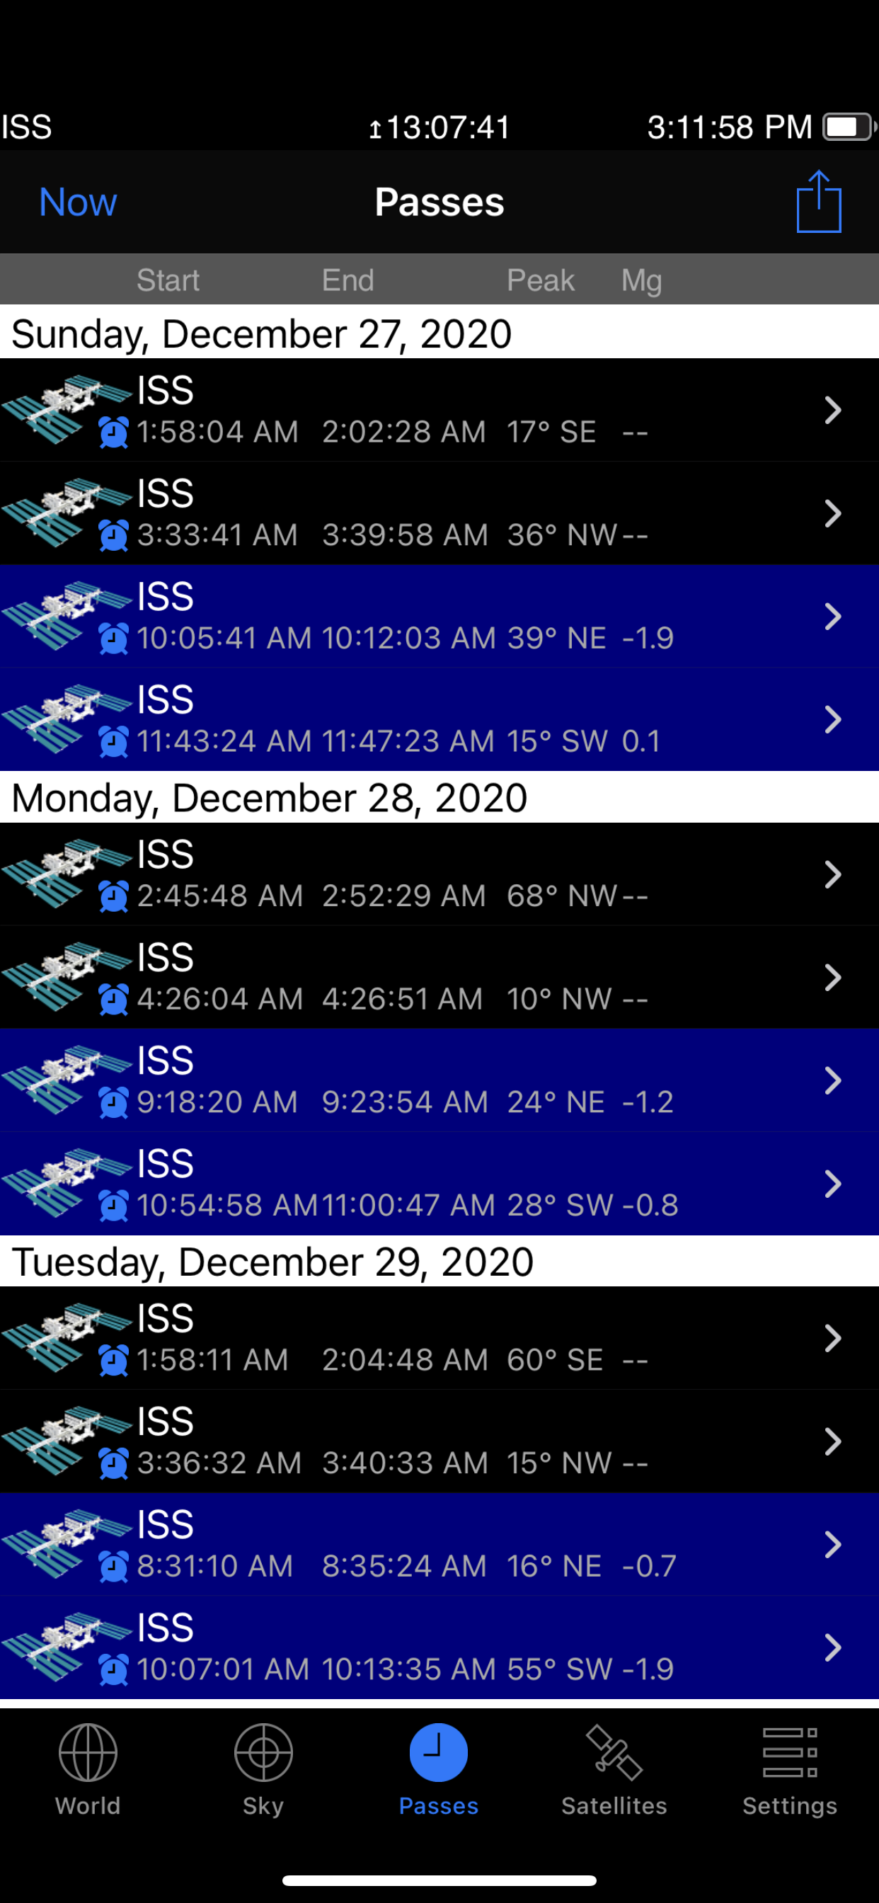
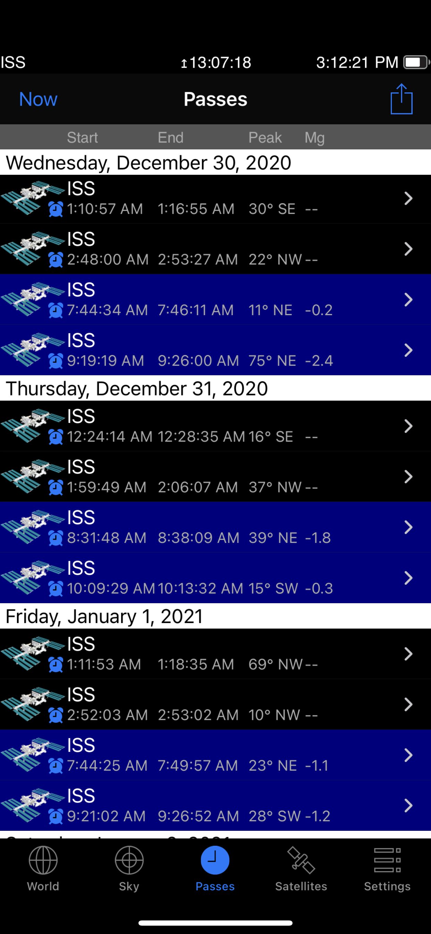
When will the ISS be over Orange County?

