Slide 1
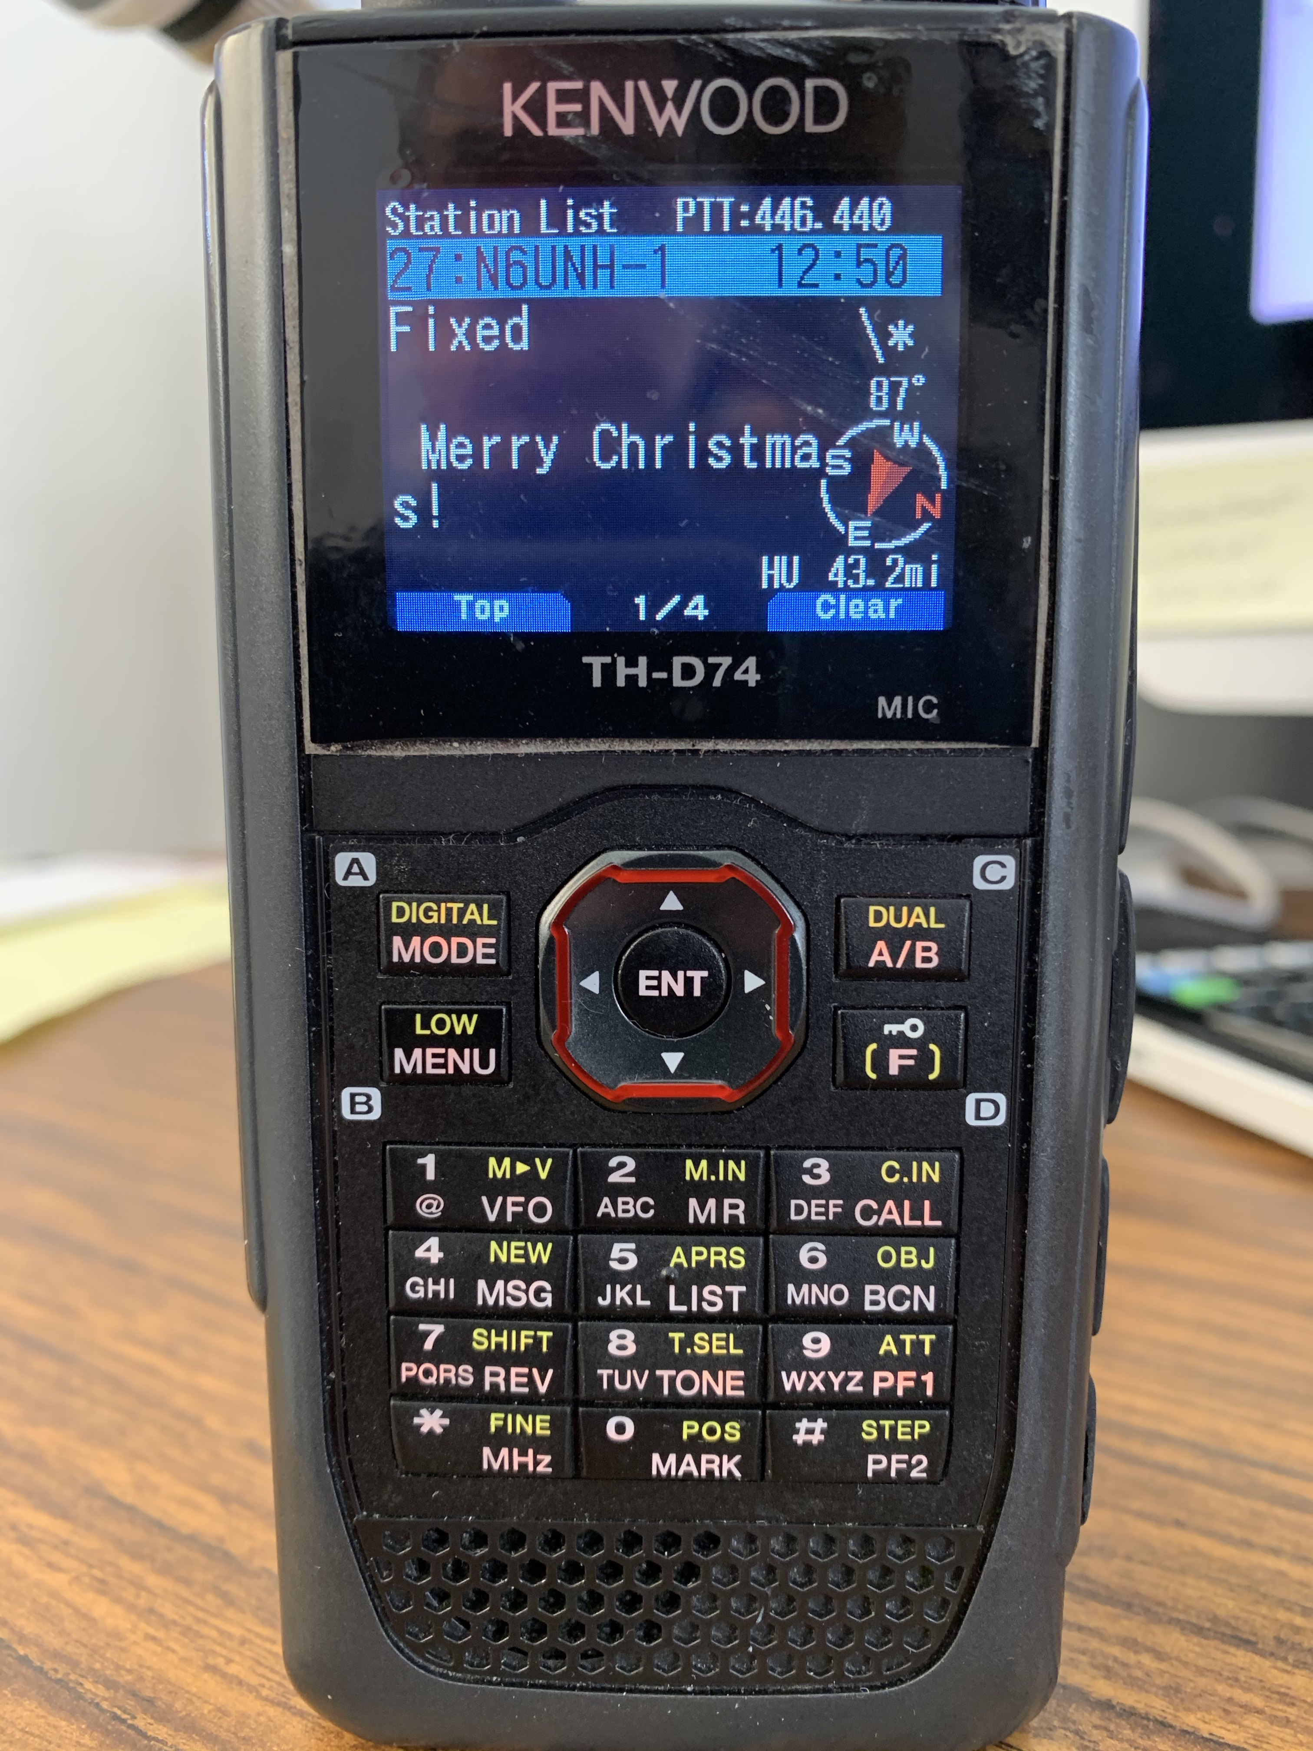

APRS
Automatic Packet Reporting System
Fullerton Radio Club 12/16/20
Bob Houghton - AD6QF - 12/16/20

Slide 2
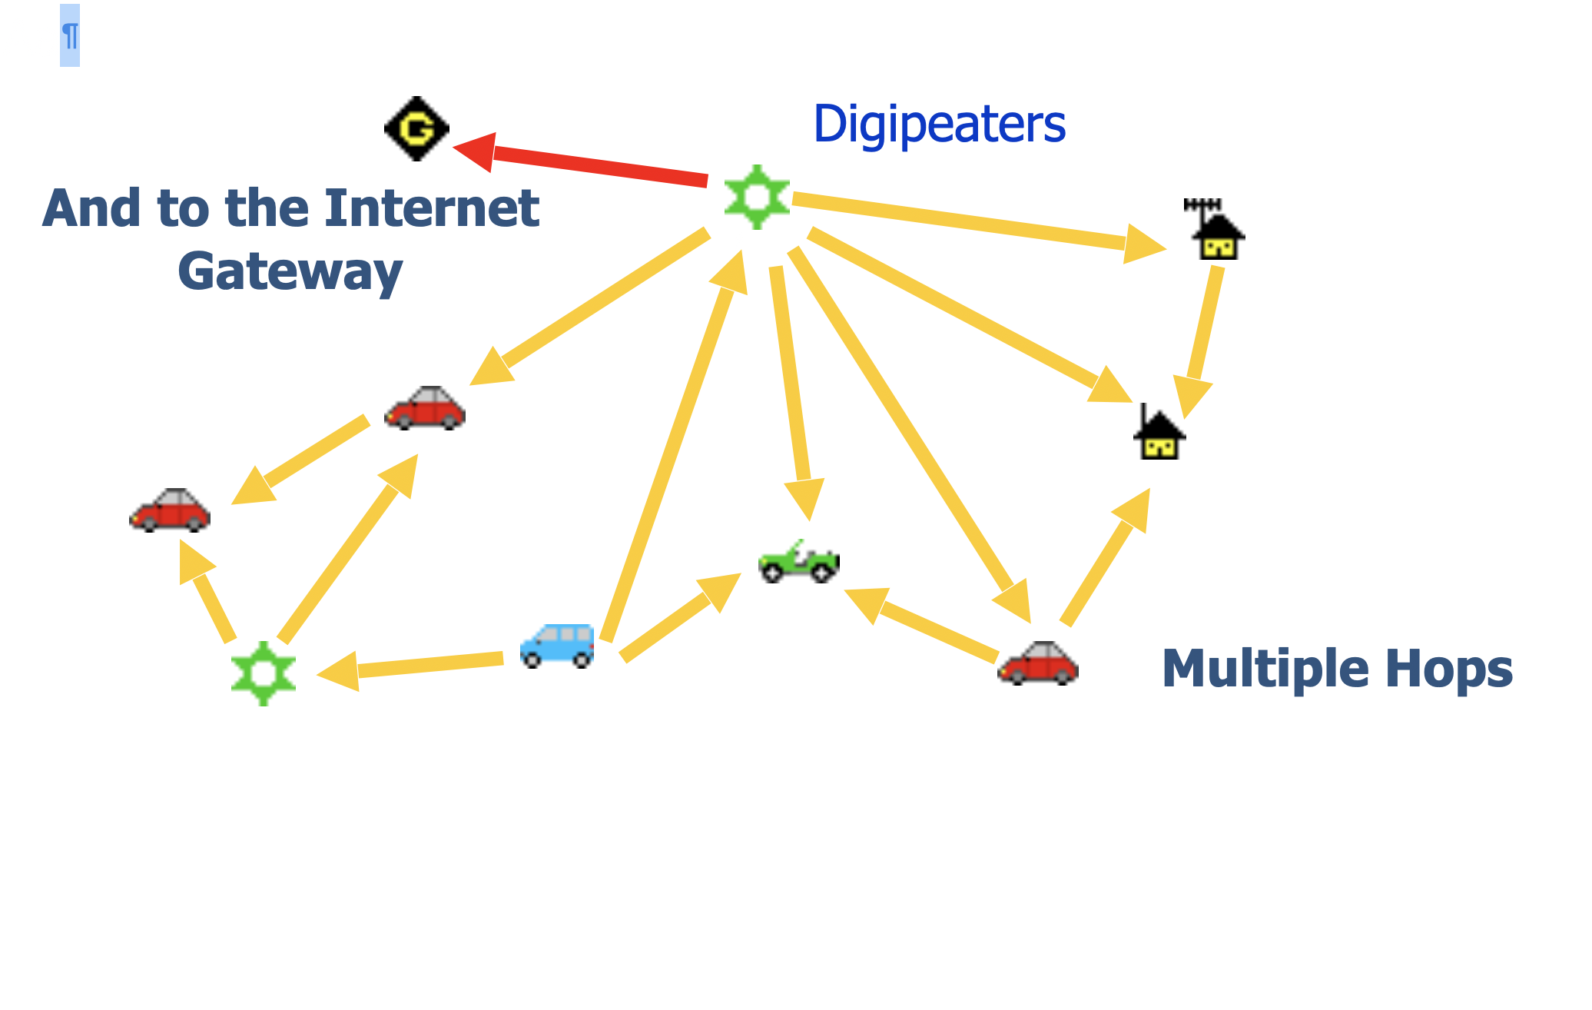
APRS
What is it?
a real-time tactical communications and display system (situational awareness)
It was designed to be a resource for the local and traveling ham to show surrounding local information of immediate value.
Is NOT primarily intended as a way to track cars on a map (although it will do that)

Slide 3


APRS
History
Developed by Bob Bruninga WB4APR (thus the name)
Introduced at the 1992 TAPR/Arrl Digital Communications Conference

Slide 4
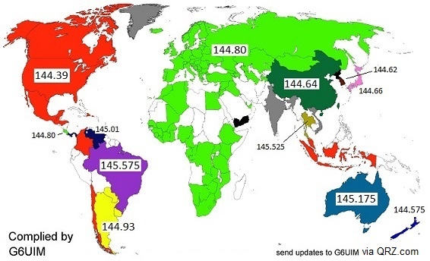
APRS
How it works
Uses packet radio
Original packet radio is point-to-point with ‘connected’ stations
APRS is point-to-many
Packet radio, but unconnected packets (no “ack”)

Slide 5
APRS
How it works - direct - without the internet
Uses radio, TNC (hardware or software), and (sometimes) a computer
Simplex mode - Generally VHF FM on 144.39 MHz (North America)
Sender’s radio transmits a packet.
Packet can contain callsign, lat/long/altitude/speed/direction, a symbol, status message, telemetry, short messages directed to specific stations
Multiple radios (in simplex range) can receive it.
No ack returned (unless it is a “message”)

Slide 6
APRS
How it works - using digipeater(s) - without the internet
Sender’s radio transmits a packet.
Packet is received by a digipeater which temporarily stores and then retransmits the packet. Like voice repeaters, digipeaters are generally at a high elevation to cover a large area
Packet can contain callsign, lat/long/altitude/speed/direction, a symbol, status message, telemetry, short messages directed to specific stations
Multiple radios (in simplex range) can receive it.
No ack returned (unless it is a “message”)

Slide 7
APRS
How it works - using digipeater(s) - combined with the internet
Specialized stations called iGates, pass APRS packets traffic from RF to the internet and vice-versa (requires a radio, TNC, and a computer - often a Raspberry Pi)
A server network (APRS-IS) manages the storing and routing of packets
APRS-IS a common name given to the Internet-based network which inter-connects various APRS radio networks throughout the world (and space)
Other servers can exchange packets with APRS-IS and make them available via the web (aprs.fi, aprsdirect.com, etc.)

Slide 8
APRS
SSIDs are station designators appended to your callsign
a station’s SSID gives you an idea of it’s purpose
The common ones to know are
  -0 for base stations
  -7 for HTs
  -9 for mobile
  Example: AD6QF-7
– 0 | Your primary station usually fixed and message capable
-1 | generic additional station, digi, mobile, wx, etc
-2 | generic additional station, digi, mobile, wx, etc
-3 | generic additional station, digi, mobile, wx, etc
-4 | generic additional station, digi, mobile, wx, etc
-5 | Other networks (Dstar, Iphones, Androids, Blackberry's etc
-6 | Special activity, Satellite ops, camping or 6 meters, etc
-7 | walkie talkies, HT's or other human portable
-8 | boats, sailboats, RV's or second main mobile
-9 | Primary Mobile (usually message capable)
-10 | internet, Igates, echolink, winlink, AVRS, APRN, etc
-11 | balloons, aircraft, spacecraft, etc
-12 | APRStt, DTMF, RFID, devices, one-way trackers*, etc
-13 | Weather stations
-14 | Truckers or generally full time drivers
-15 | generic additional station, digi, mobile, wx, etc

Slide 9
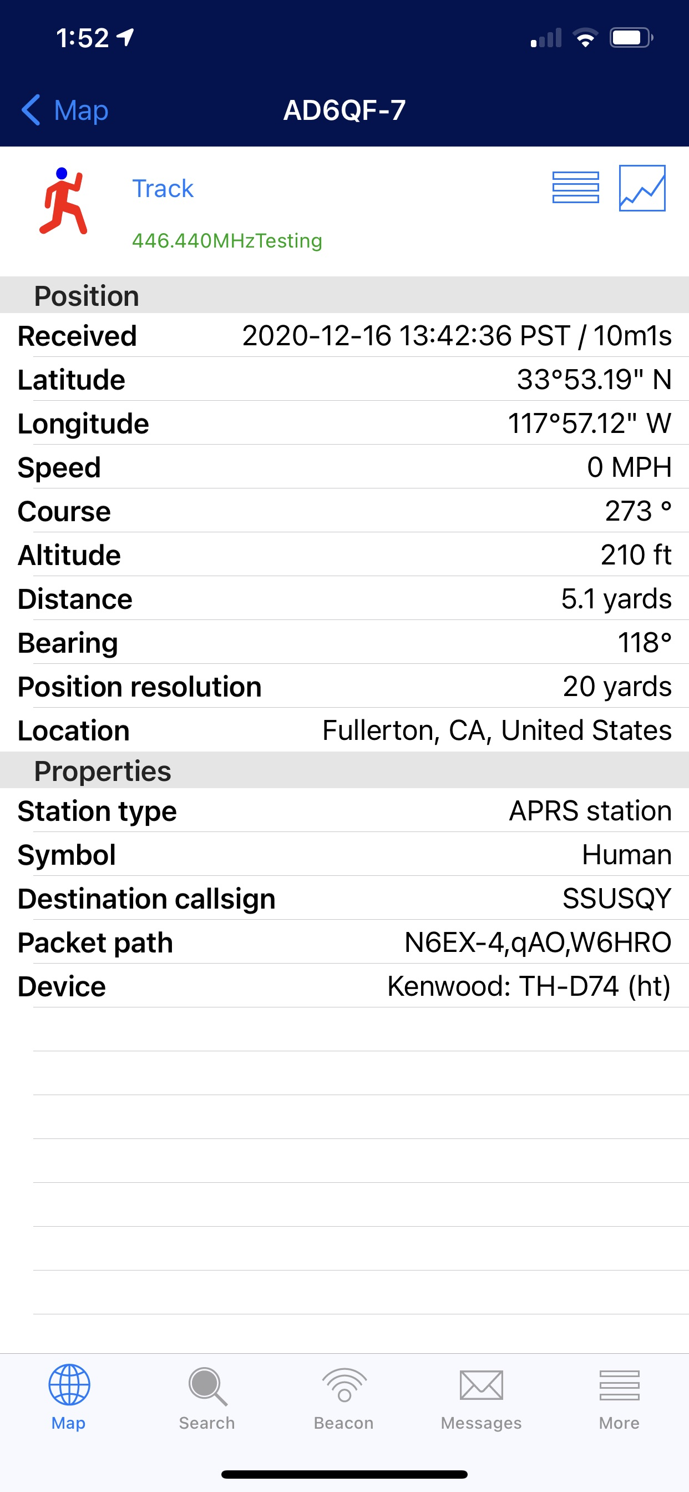
APRS
What’s needed?
To observe
  aprs.fi
  aprsdirect.com
To participate
  radio, TNC, computer or tablet
  cellphone or tablet w/app
  APRS capable radio

Slide 10
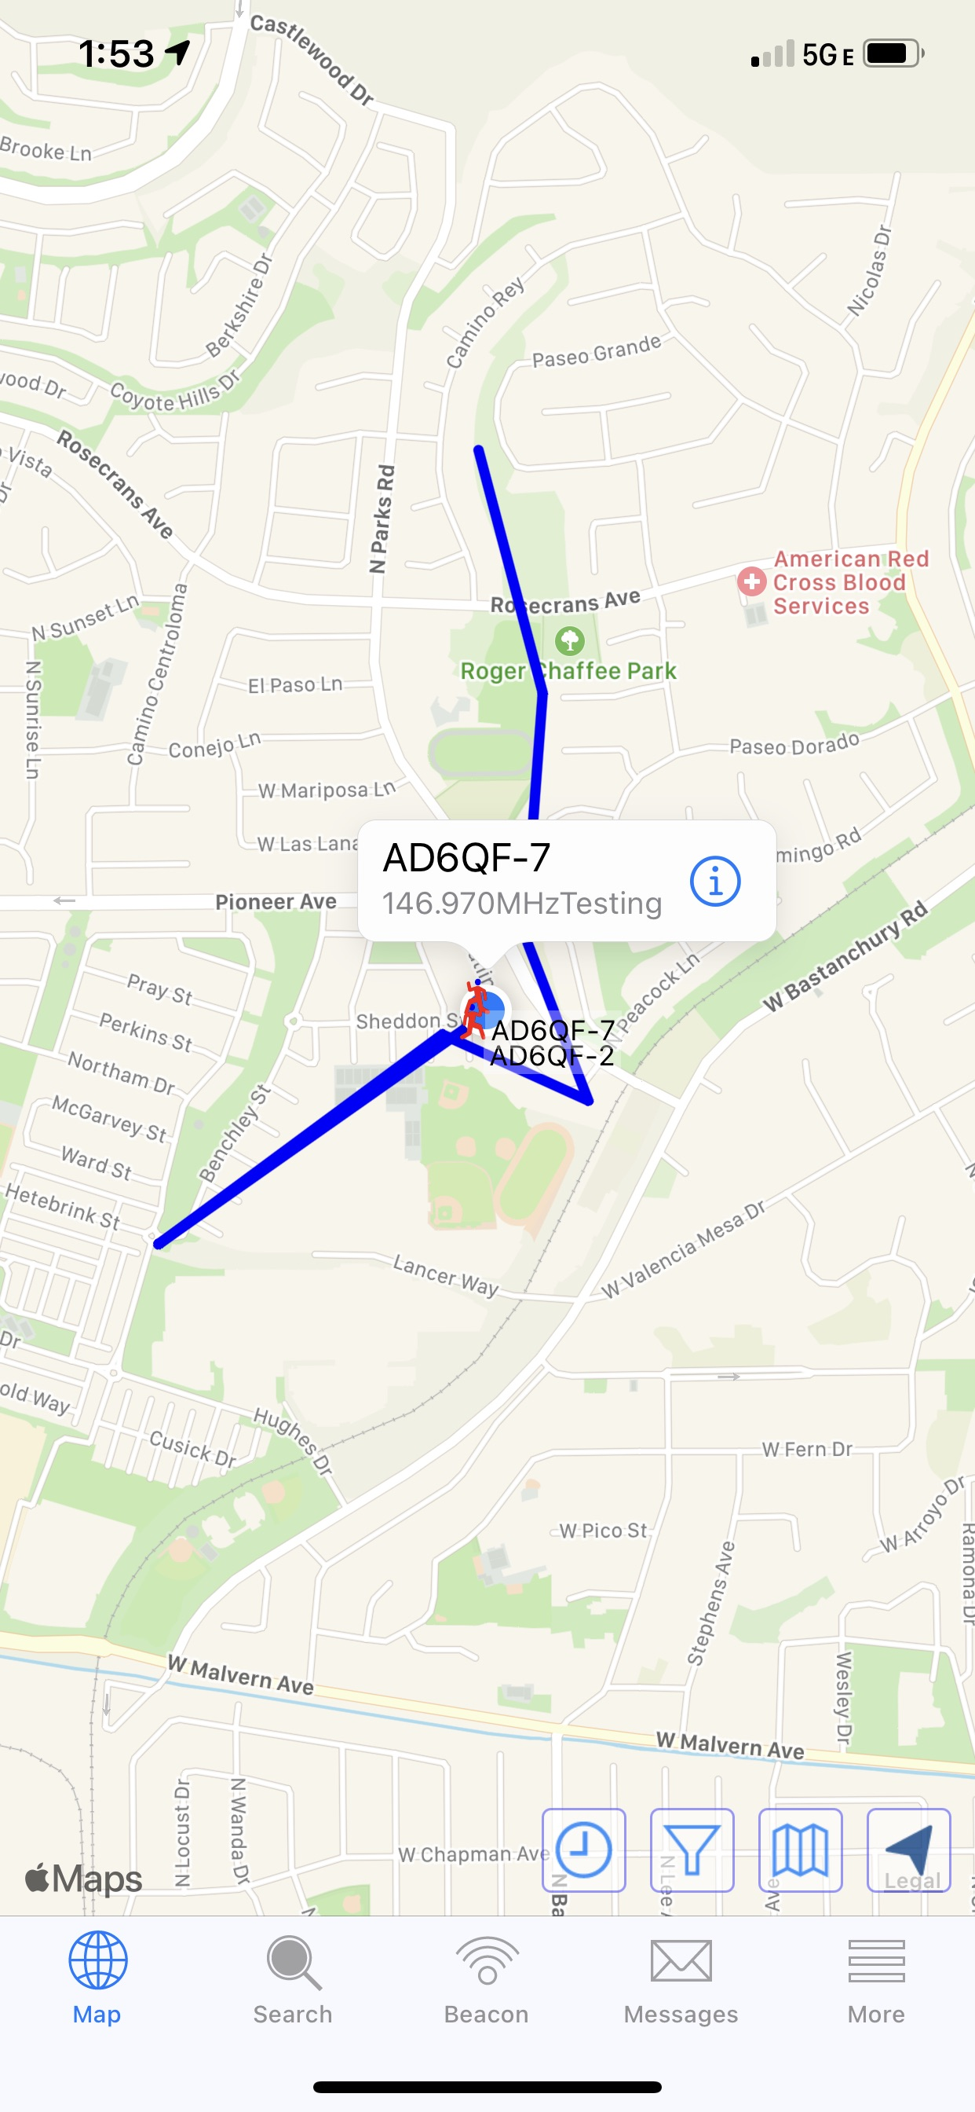
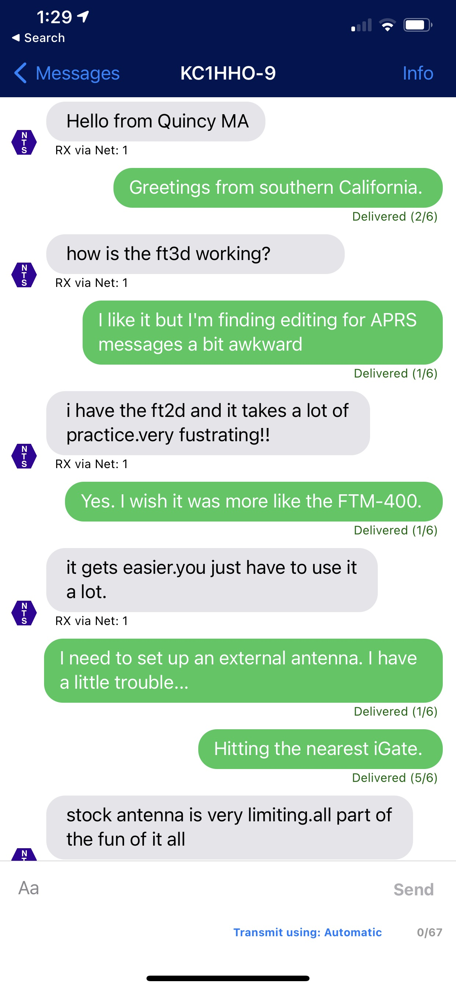
APRS
Beaconing vs. messages
Beaconing is a broadcast
  Contains information of interest to the general recipient
  Location, beacon status text, wx information, telemetry

Slide 11
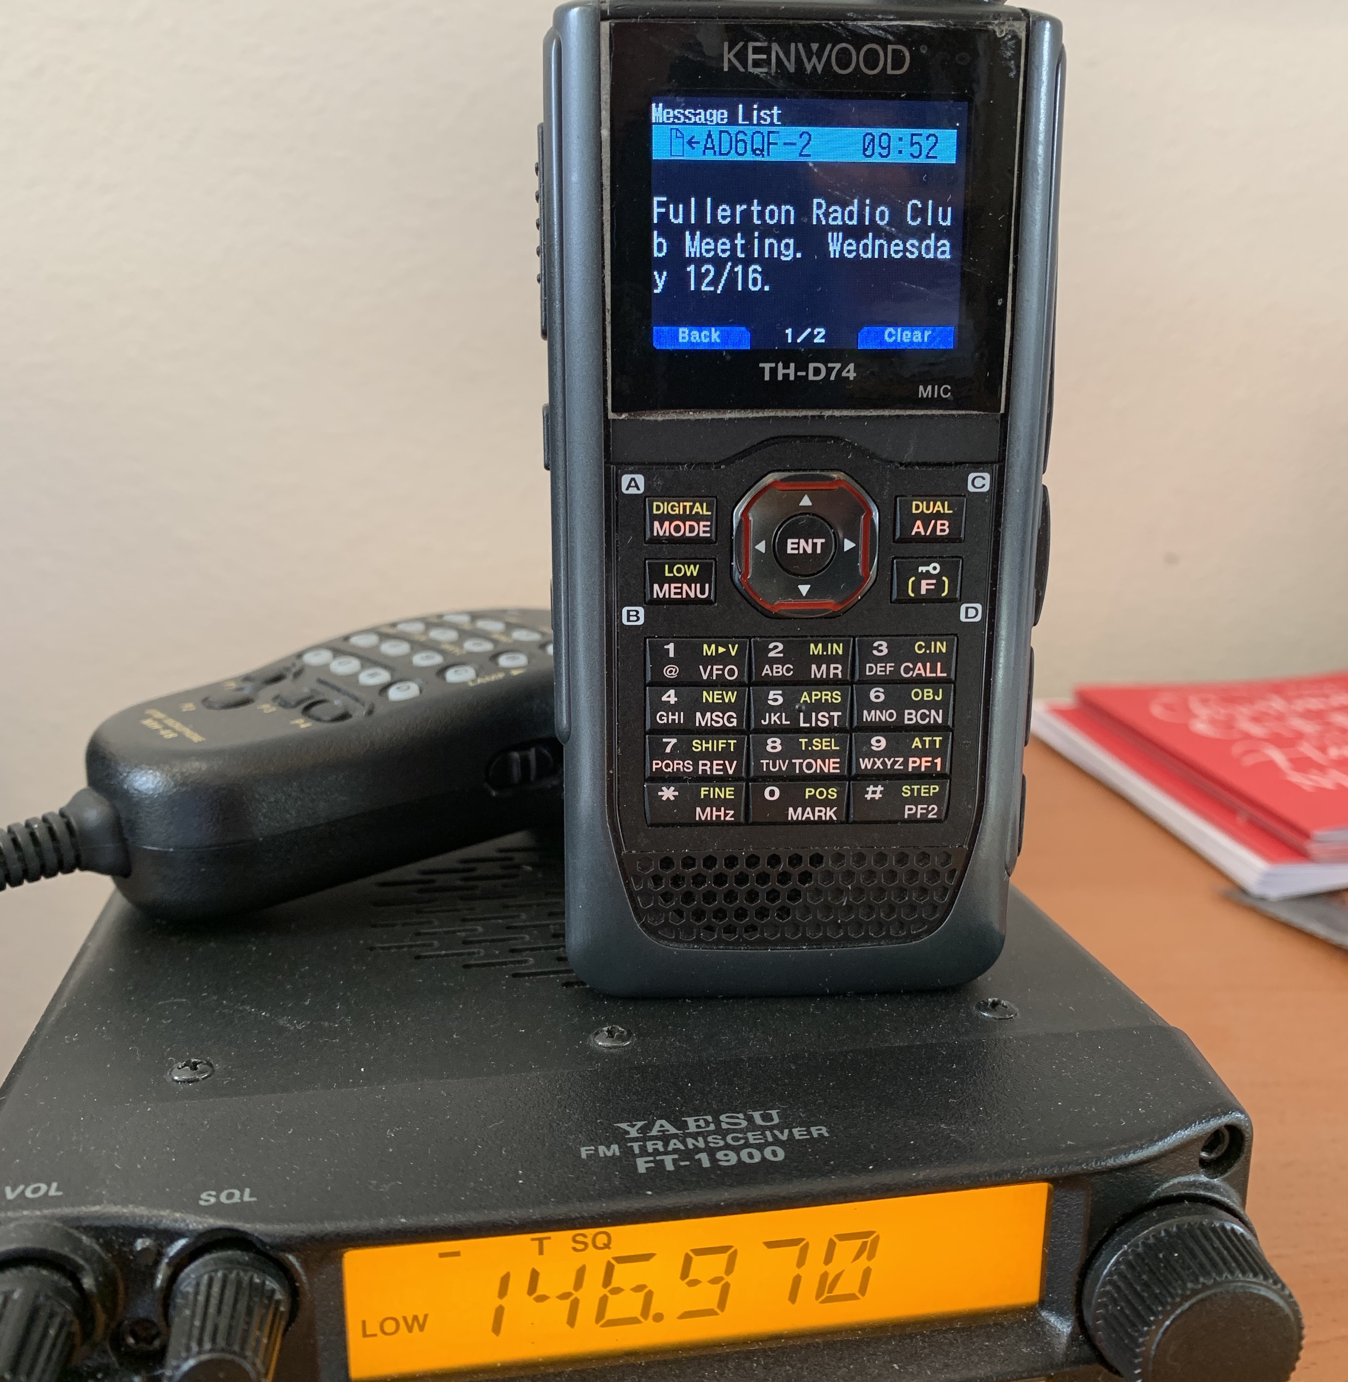
APRS
Beaconing vs. messages
Messages are station-to-station
But are not private (still packets)
If station A has beaconed recently, it will be known to the APRS-IS network
If station B sends a message to station A, the APRS-IS network will route the message to the last iGate that heard station B

Slide 12
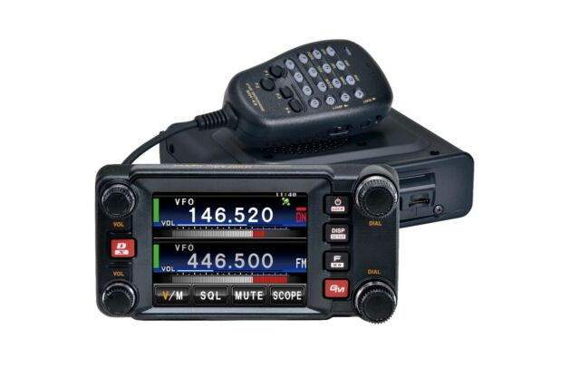
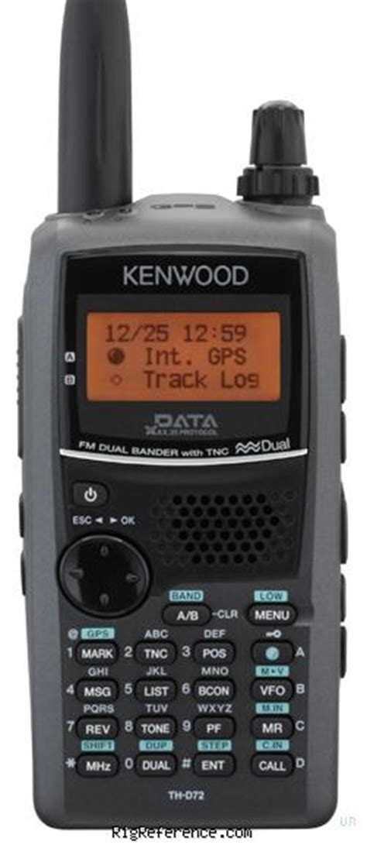
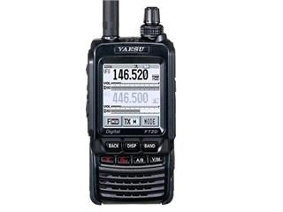
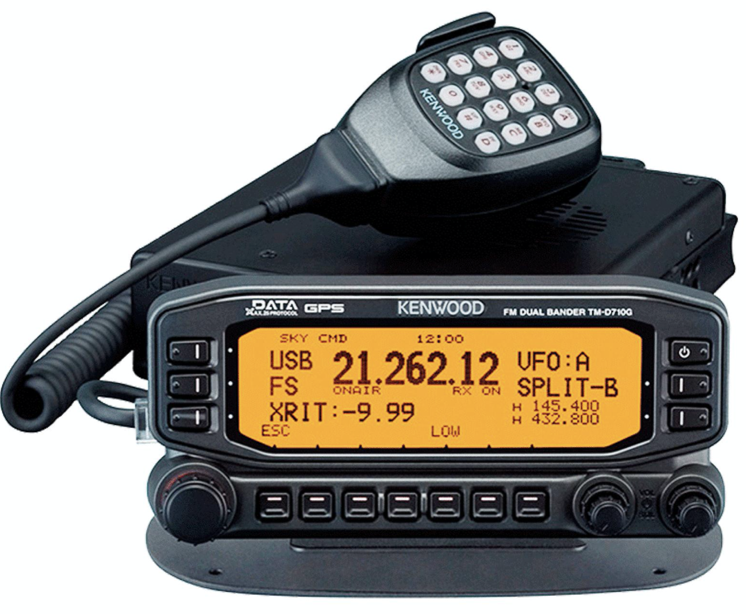
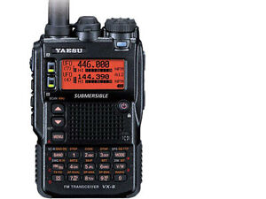
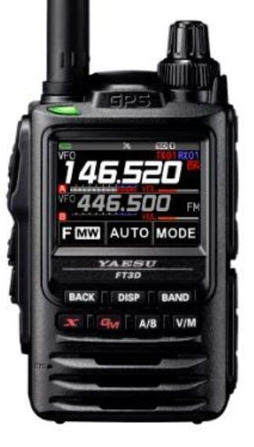
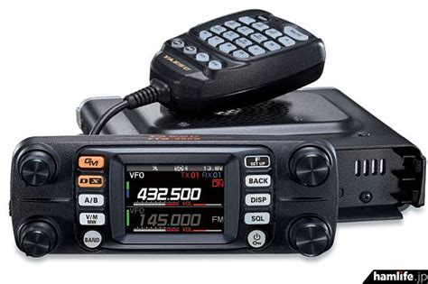
APRS
APRS-capable radios
Stand-alone (built-in TNC)
  Kenwood TH-d7, d72, d74
  Kenwood TM-700, 710G
  Yaesu FT-8, FT1DR, FT2DR, FT3DR
  Yaesu FTM-100, 300, 350, 400
  Icom has some DPRS radios that send APRS to the internet but do not use analog rf digis
  There are others

Slide 13
APRS
Other solutions
Mobilnkd 2 ($65) + Computer w/bluetooth or Android device + radio
Moblinkd 3 ($120) + Computer or iOS device (or Android device) + radio
Better than an APRS-capable HT due to detailed map on tablet, computer, or cellphone

Slide 14


APRS
Non-rf solutions
aprs.fi app for iOS ($7+)
aprsDroid app for android
($5 Google play store or OpenSource supportware)

Slide 15
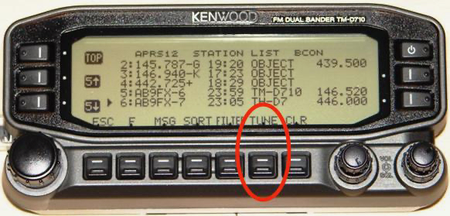
APRS
Mobile frequency beaconing
This is a way for hams to “find each other” by announcing the frequency they are currently monitoring.
The frequency of your VFO A is included in the status text of your beacon. Other hams can see this.
When you receive a station with frequency info included in your beacon you press the TUNE button to switch to that frequency

Slide 16
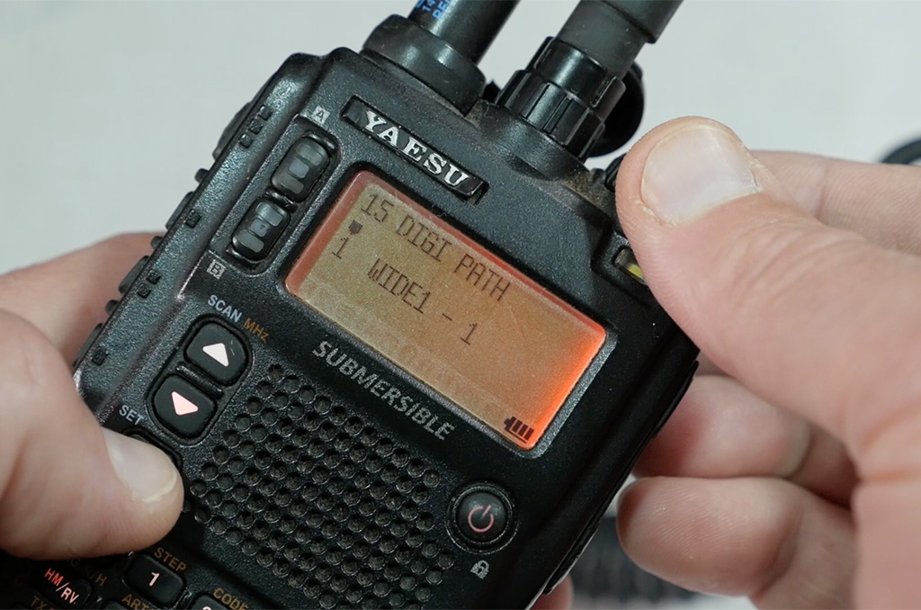
APRS
Future topics to explore
What are paths?
What does Wide 1-1 mean?
How do I send an APRS message to somebody’s email address?
How do I send and receive aprs messages to SMS?
What is smart beaconing

Slide 17
Questions?

Slide 18
Where do we go from here?

